Slide 1
Welcome to:
CANCER PROGRESS: How Far Have We come and what’s next?
We’ll Get Started in just a few minutes

Slide 2
Moderated by
William G. Nelson, MD, PhD Editor-in-Chief of Cancer Today
Marion I. Knott Professor of Oncology & Director of the Sidney Kimmel
Comprehensive Cancer Center at Johns Hopkins

Slide 3
A Look at cancer progress in 2017
Michael A. Caligiuri, MD AACR President, Chair of the AACR Cancer Progress Report Steering Committee
Director of The Ohio State University Comprehensive Cancer Center
CEO of the Arthur G. James Cancer Hospital and Richard J. Solove Research Institute

Slide 4
AACR CANCER PROGRESS REPORT 2017
www.CancerProgressReport.org

Slide 5
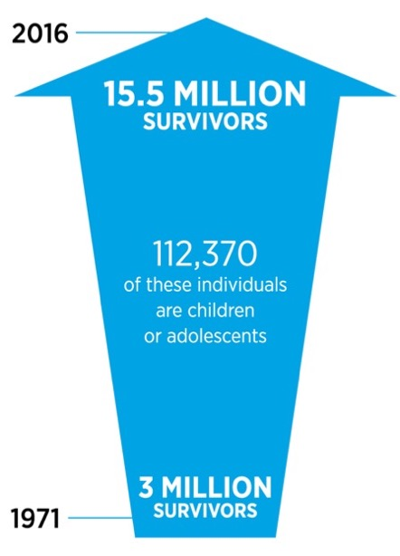
THERE HAS BEEN MAJOR PROGRESS AGAINST CANCER IN THE U.S.
American Association for Cancer Research Cancer Progress Report 2017

Slide 6
RESEARCH CONTINUES TO POWER ADVANCES FOR PATIENTS
Since August 2016, the FDA has approved 16 new drugs;
New uses for eight previously-approved drugs; and
One new optical imaging agent.
Teri Woodhull
Ovarian Cancer
Evan Freiberg, MD, PhD
Leiomyosarcoma
Bill McCone
Head and Neck Cancer
Carrie Best
Merkel Cell Carcinoma
Adrienne Skinner
Metastatic Ampullary Cancer

Slide 7
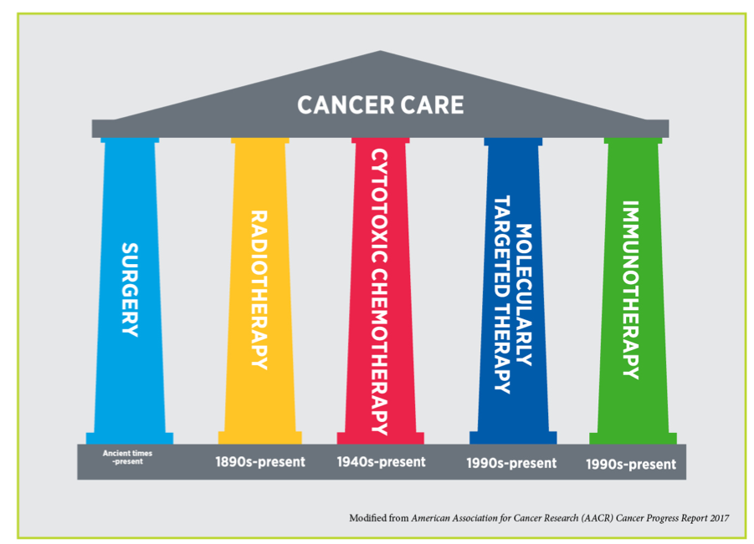
THE EVOLUTION OF CANCER CARE

Slide 8
TARGETED THERAPY
Therapies directed to the molecules involved in different aspects of the cancer process target the cells within a tumor more precisely than chemotherapy.
The greater precision of these drugs tends to make them more effective and less toxic.
Targeted therapies are central to precision medicine.

Slide 9
IMMUNOTHERAPY
Cancer immunotherapies work by unleashing the power of a patient’s immune system to fight cancer the way it fights the cold virus.
American Association for Cancer Research Cancer Progress Report 2017

Slide 10



WHAT IS BIG DATA?
It can enhance our knowledge of cancer and lead to new breakthroughs.

Slide 11
CANCER: MORE WORK TO BE DONE
American Association for Cancer Research Cancer Progress Report 2017

Slide 12
PREVENTING CANCER
More than half of global cancer cases are a result of preventable causes
American Association for Cancer Research Cancer Progress Report 2017

Slide 13
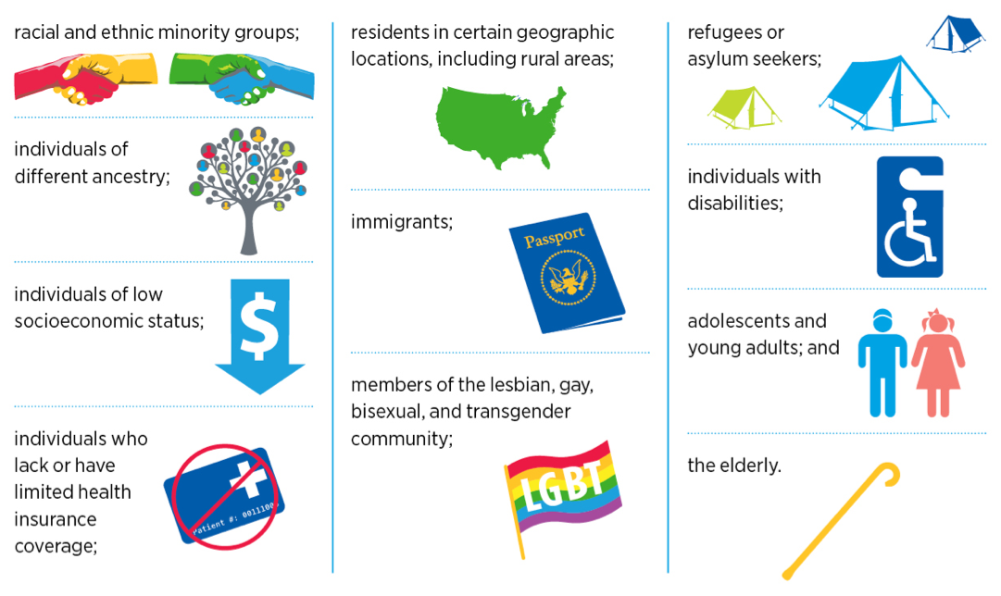
U.S. CANCER HEALTH DISPARITIES
Modified from the American Association for Cancer Research Cancer Progress Report 2017

Slide 14
My Cancer story
Adrienne Skinner Cancer Survivor Through Clinical Trials

Slide 15

ABOUT ME:
I am a 60-year-old single mother of four daughters.
I live in a New York City suburb and work in New York City.
I live with a genetic mutation that causes Lynch syndrome.
I was diagnosed with ampullary cancer in February 2013.

Slide 16
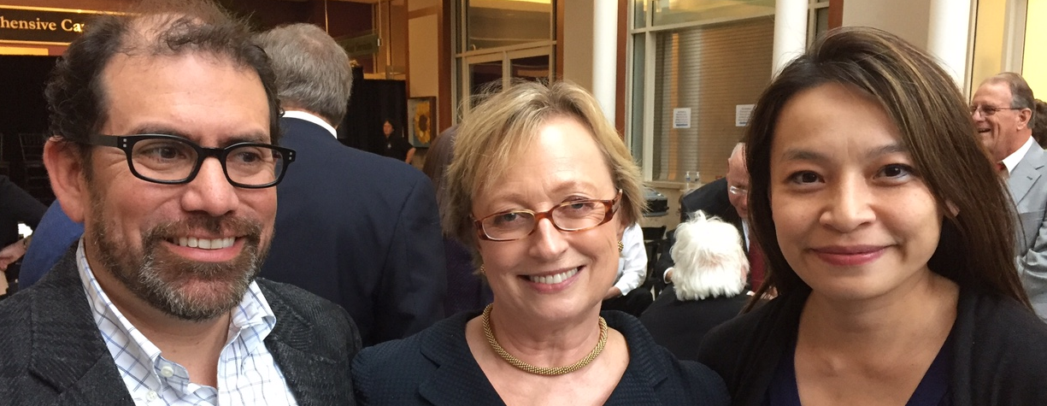
THE CLINICAL TRIAL THAT SAVED ME
Phase II study of Keytruda (Merck) in patients with MSI tumors
Began treatment on April 15, 2014
Immediate reduction in blood markers for cancer
Surgical biopsy on July 29, 2014, found no evidence of tumor

Slide 17
Medical Research Funding: Making Your Voice
Heard on Capitol Hill
George D. Demetri, MD Chair, AACR Science Policy & Government Affairs Committee and member, AACR Board of Directors
Professor of Medicine, Dana-Farber Cancer Institute and Harvard Medical School
Co-Director, Ludwig Center at Harvard

Slide 18
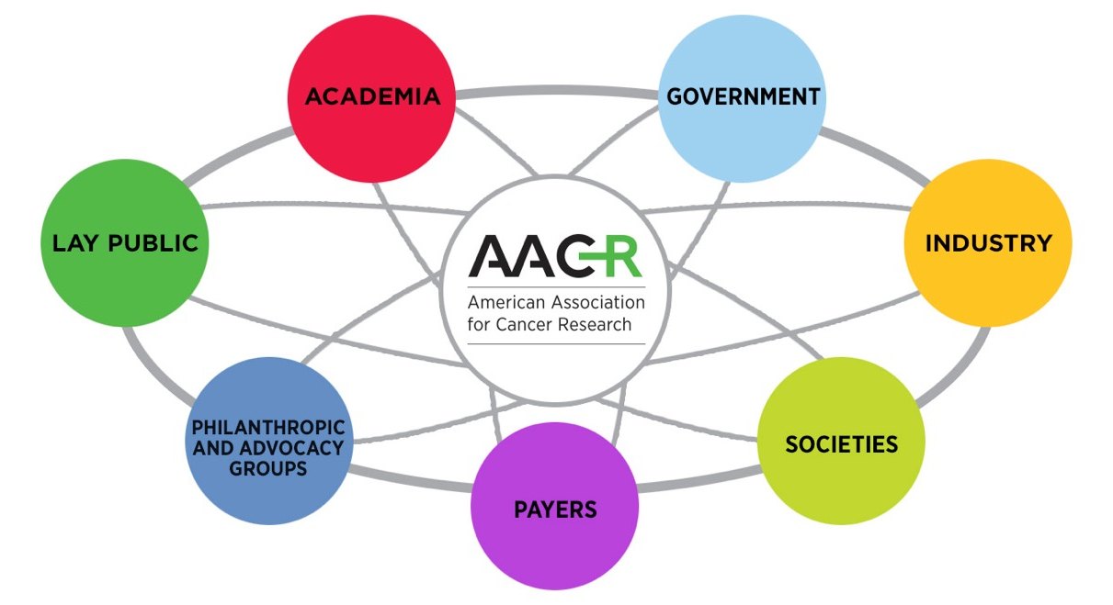
MORE PROGRESS, MORE HOPE, AND MORE LIFE CAN BE ACHIEVED FOR THE BENEFIT OF CANCER PATIENTS

Slide 19
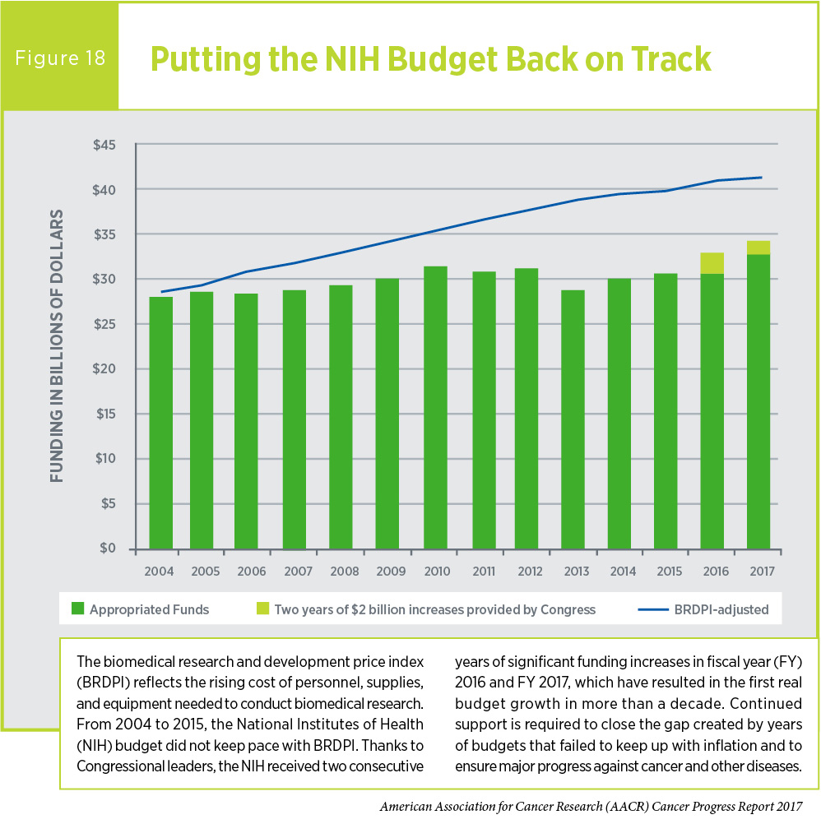
NATIONAL INSTITUTES OF HEALTH – Cornerstone of Medical Research in the United States

Slide 20
MOMENTUM FOR MEDICAL RESEARCH FUNDING
Despite more than a dozen years of flat funding, the House and Senate have shown strong bipartisan support for the National Institutes of Health over the past two years.
In both fiscal year (FY) 2016 and FY 2017, Congress provided a $2 billion increase for the National Institutes of Health (NIH) – a 13 percent increase over two years.
Proposed increases for the NIH in both chambers in FY 2018
House Appropriations Committee approved a $1.1 billion increase.
Senate Appropriations Committee approved a $2 billion increase.
Continuing to implement the 21st Century Cures Act and funding the Beau Biden Cancer Moonshot ($1.8 billion over seven years)

Slide 21
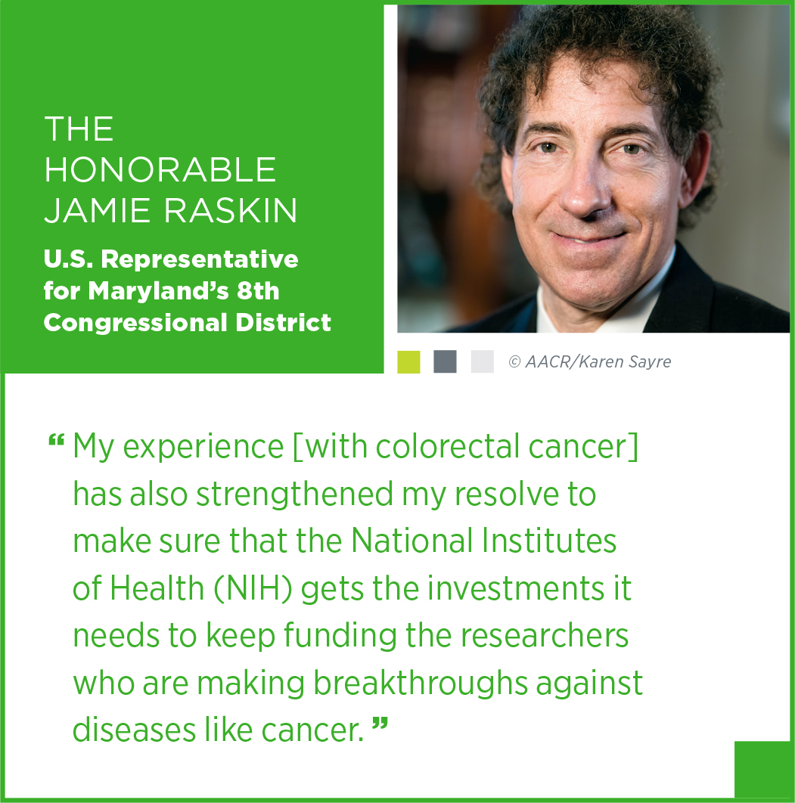
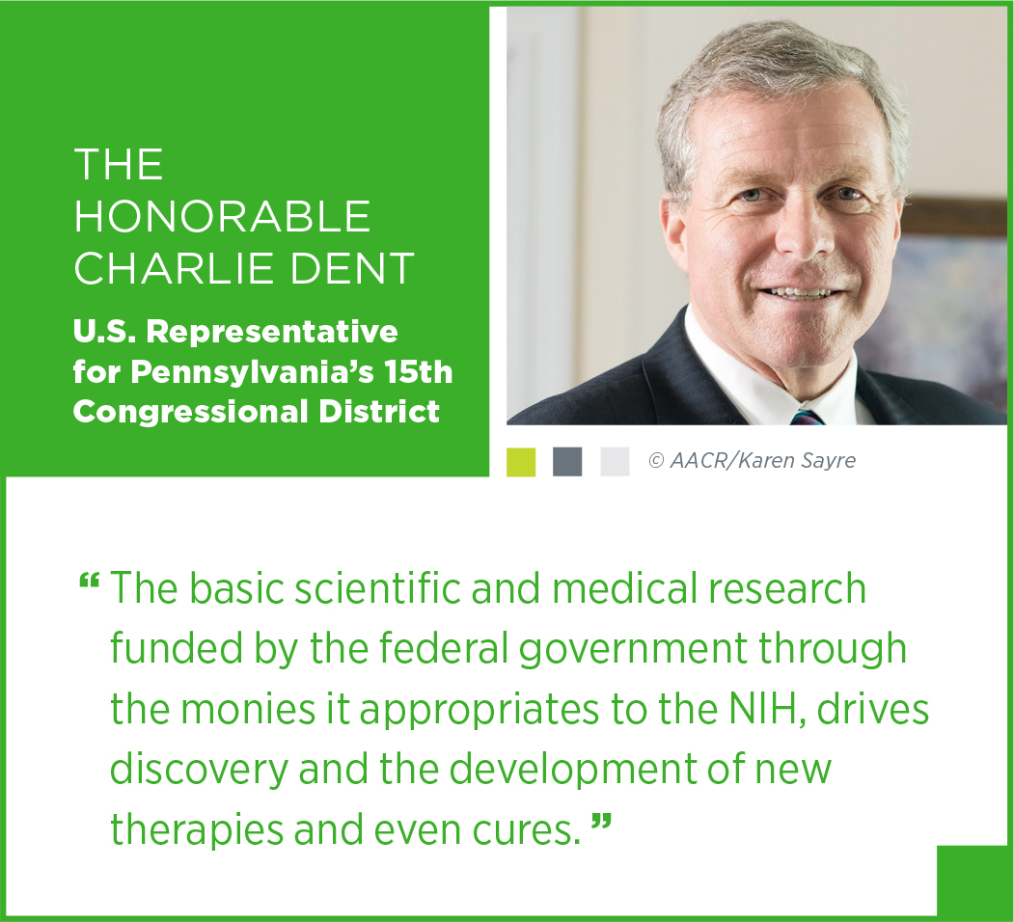
CONGRESSIONAL SUPPORT FOR MEDICAL RESEARCH

Slide 22
AACR ADVOCACY RESOURCES
Sign up for the AACR Cancer Policy Monitor
Policy newsletter distributed biweekly to members
AACR ENGAGE website
www.aacr.org
AACR Advocates Facebook Group
AACR Scientist↔Survivor Program

Slide 23
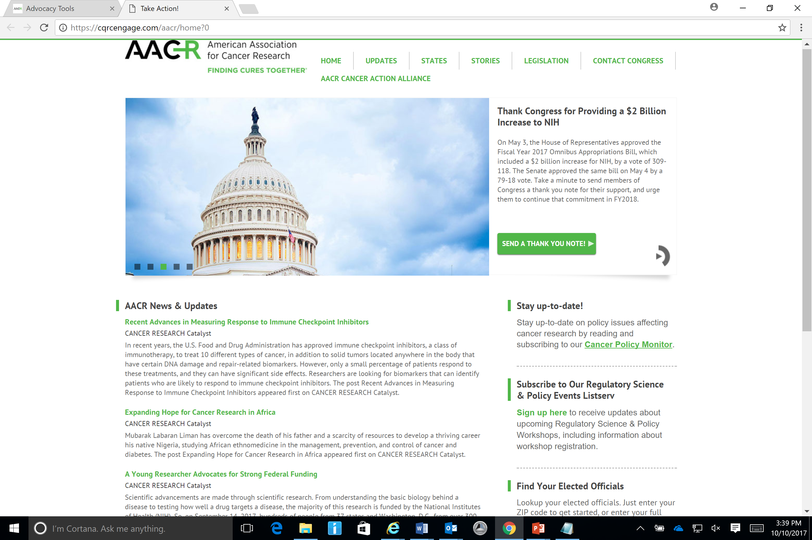
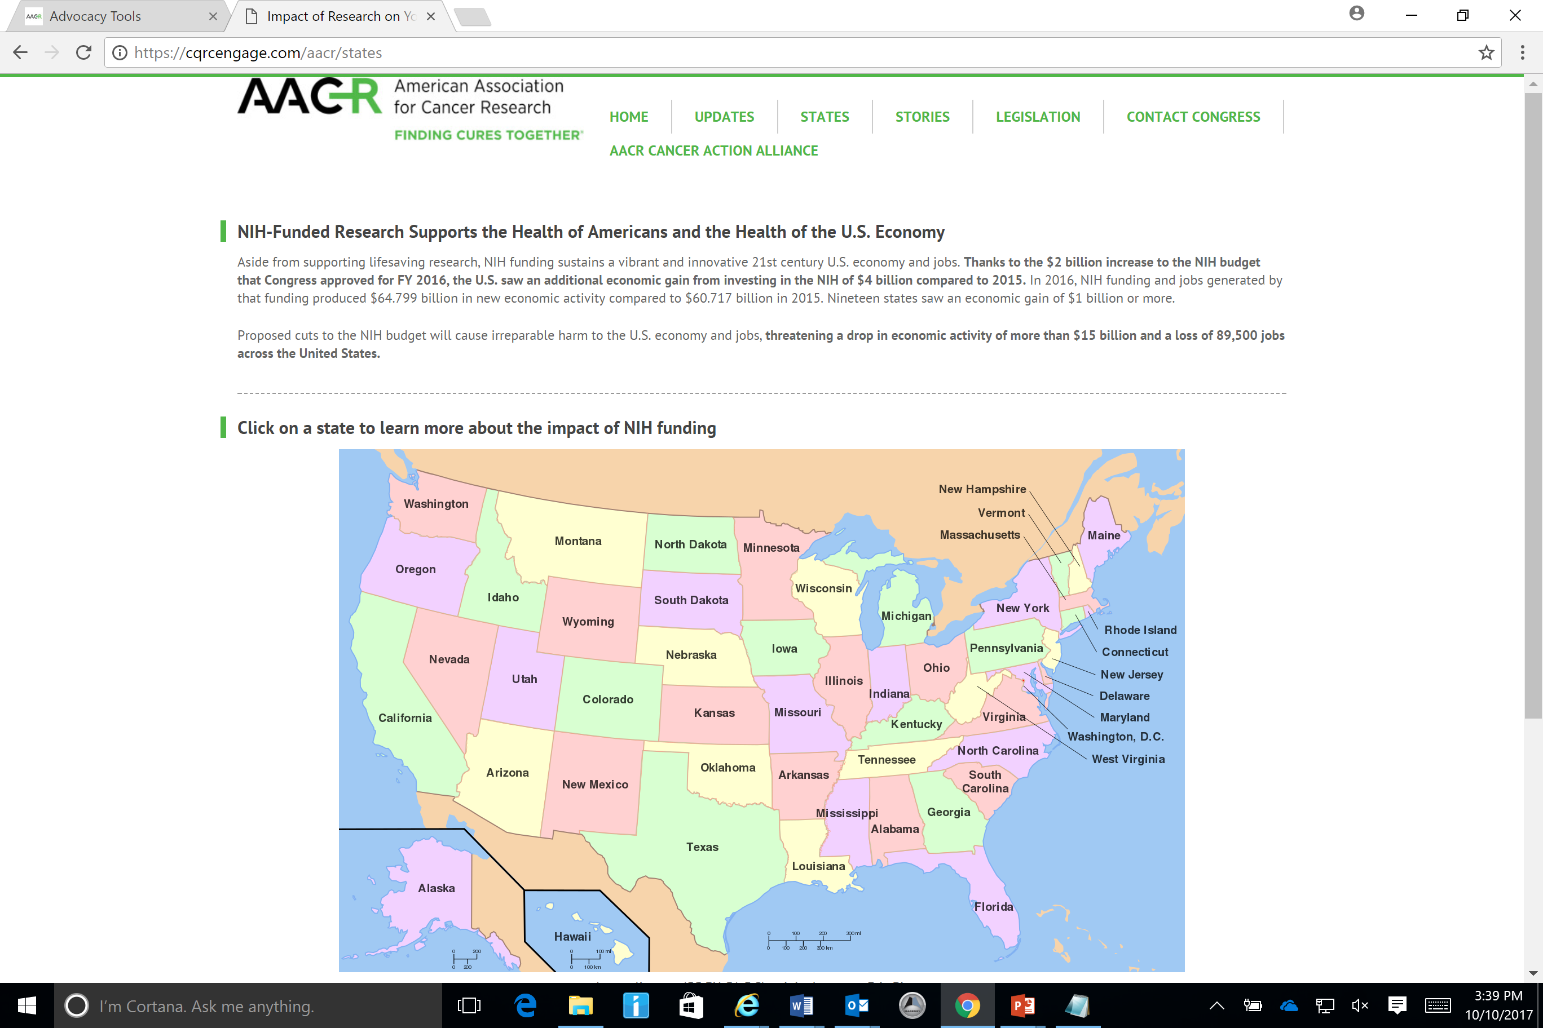
AACR ADVOCACY RESOURCES

Slide 24


MORE WAYS TO GET INVOLVED
Get connected with elected officials.
Sign up for your Congressman’s newsletter.
Connect with your Congressman on Facebook.
Follow your Congressman on Twitter.
Request an in-district meeting with your member of Congress.

Slide 25
Questions & Answers

Slide 26
Thank You for attending
CANCER PROGRESS: How Far Have We come and what’s next?
We Hope to see you on future webinars!

