Slide 1
Let’s End HPV-Related Cancers
Anna R Giuliano, PhD
Center for Immunization and Infection Research
in Cancer (CIIRC)
Moffitt Cancer Center

Slide 2
Every 2 minutes
one more woman dies from cervical cancer
Notes:
Image: Freepik.com

Slide 3
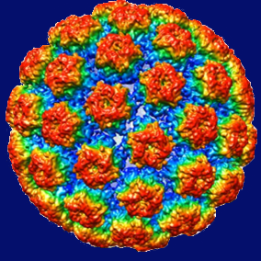
Human Papillomavirus (HPV) is a common virus
1 out of 20 cancers in men and women is caused by HPV
>$10 billion are spent annually in the US to diagnose and treat HPV-related diseases

Slide 4
HPV Causes Multiple Cancers in
Men and Women
% cancer cases caused by HPV in the U.S
Cervical Cancer
100%
Head & Neck Cancer
Vulvar Cancer
80%
50%
HPV
Penile cancer
Anal Cancer
50%
Vaginal Cancer
80%
50%

Slide 5
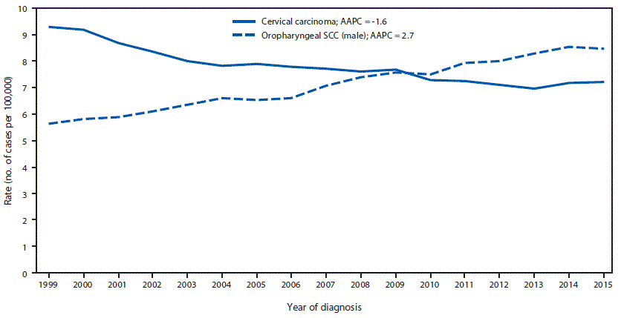
Decreasing Cervical Cancer Incidence and Increasing Male Oropharyngeal Cancer Incidence
US NPCR and SEER data
Annual Percent Change (APC)
Cervical = -1.6%
Oropharyngeal = 2.7%
Van Dyne et al MMWR August 2018
Notes:
Chaturvedi 2011
p4299, fig4A

Slide 6
Infection/Disease Control to Extinction
Control
Reduction of disease incidence, prevalence, morbidity, and mortality to acceptable levels
Elimination of Disease
Reduction to zero, or near zero, incidence of disease in a defined geographic area
Elimination of Infection
Reduction to zero, or near zero, incidence of infection caused by a specific agent in a defined geographic area
Eradication
Permanent reduction to zero worldwide incidence of infection caused by a specific agent
Extinction
The specific agent no longer exists in nature or the laboratory
Dahlem, Workshop on Eradication of Infectious Diseases, 1997

Slide 7
To Eliminate Cervical Cancer
Vaccine
Treatment
Screening

Slide 8
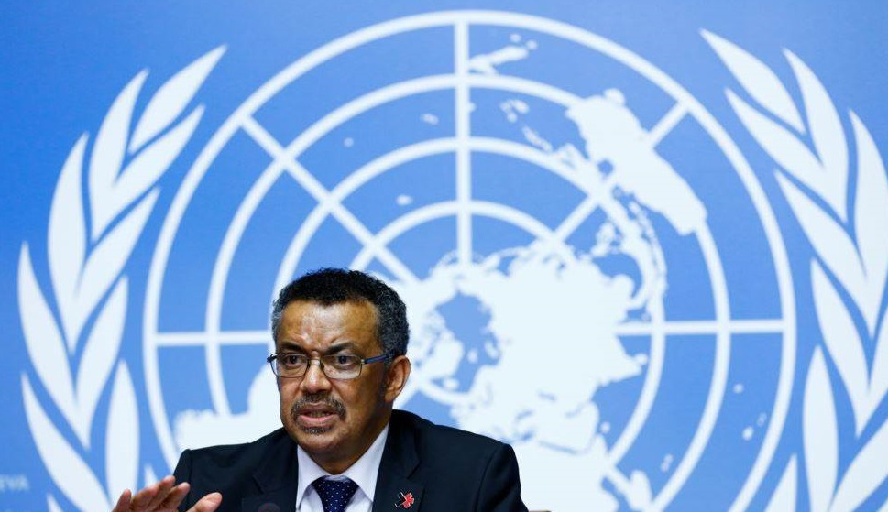
Dr. Tedros Adhanom Ghebreyesus Director-General, WHO
“I am calling for coordinated action globally to eliminate #CervicalCancer...We have the tools and, crucially, the political commitment to achieve it.”
May 19, 2018

Slide 9
All 70 NCI-Designated Cancer Centers
Endorse Goal of Eliminating HPV-Related Cancers
June 7, 2018
As national leaders in cancer research and cancer care, we issue the following call to action in alignment with the nation’s Healthy People 2020 goals: vaccination of more than 80% of males and females ages 13-15 by 2020; screen 93% of age-eligible females for cervical cancer; and provide prompt follow up and proper treatment of females who screen positive for high grade cervical precancerous lesions.
Statement supported by:
ASCO, AACI, AACR, ASPO, the Prevent Cancer Foundation, and the ACS

Slide 10
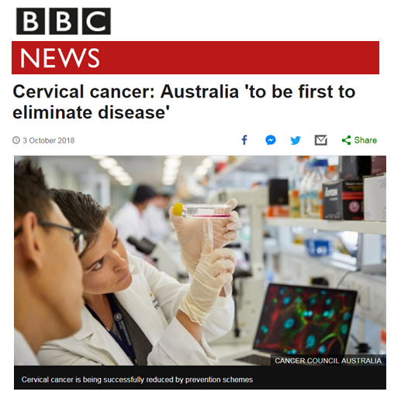
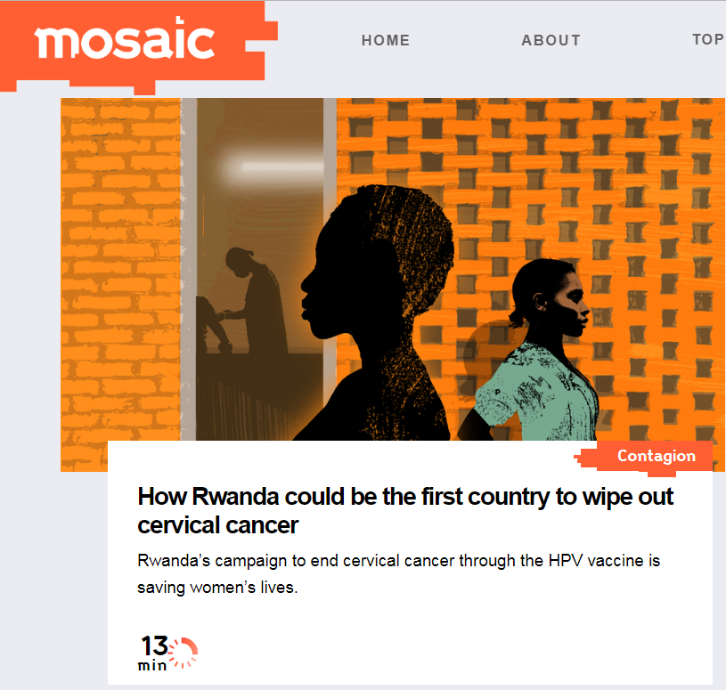
Countries that have declared they will be the first to eliminate cervical cancer:

Slide 11
We have the tools to eliminate HPV-related cancers, starting with cervical cancer
“Knowing is not enough; we must apply.
Willing is not enough; we must do.”
-Goethe

