Slide 1
Research Update: The HPV Vaccines
John T. Schiller, Ph.D.
NIH Distinguished Investigator

Slide 2
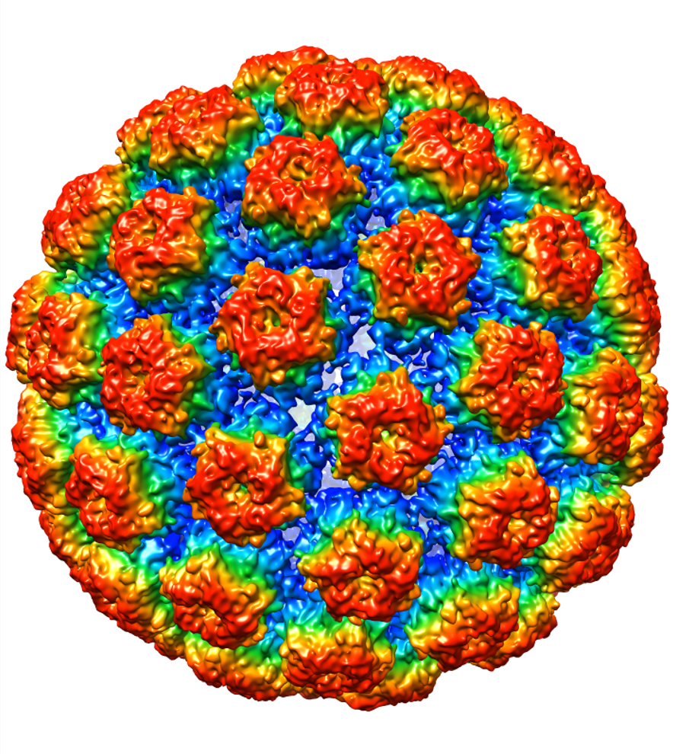
The HPV Vaccines: Basic Features
Comprised of ”Virus-Like Particles” (VLPs).
Assemblages of 360 copies of a single virion protein:
noninfectious “subunit” vaccines.
Three commercial vaccines with VLP of 2, 4, or 9 strains:
only Gardasil 9 sold in the U.S.
Consistently induce high level and long lasting strain-restricted
antibody responses that prevent viral infection.

Slide 3
The HPV Vaccines: What They Do
In clinical trials, they prevented virtually 100%
of incident infections by the vaccine-targeted strains
and the premalignant lesions that arise from them.
In national immunization programs with high coverage,
they have dramatically reduced the prevalence of targeted
HPV infections and lesions.
Not effective as treatment for established infection or lesions.

Slide 4
HPV VLP Vaccines: An Excellent Safety Record
Low grade and transient injection site
reactions are common.
Systemic reactions, when they occur,
are mild and self-limiting.
Synocope (fainting) is sometimes
observed (needle related).
No patterns of serious adverse events
in trials or post-licensure surveillance
suggesting a causal relation to the vaccine.
Notes:
The important point here is that the vaccines have very high efficacy if the analysis is restricted to protection disease caused from new infection by vaccine-targeted types. The vaccines have limited prophylactic activity against other HPV types and don’t induce lesion regression. The mostly likely explanation for the the somewhat lower efficacy in men is that it is easier miss pre-existing infections of the maie genitalia.

Slide 5
The HPV Vaccines:
An example of an effective Public/Private partnership
NIH-sponsored research to understand HPV/cancer
and discover vaccine.
Industry-sponsored product development, manufacture,
and sales.
CDC-sponsored uptake and impact monitoring.

Slide 6
What’s Limiting the Potential Impact of HPV Vaccines?
Limited Uptake!
High Income Countries: Vaccine hesitancy
Middle Income Countries and Low Income Countries: Access
- cost of vaccine and implementation
- vaccine shortage: next 5 yrs (not in U.S.)
Notes:
The important point here is that the vaccines have very high efficacy if the analysis is restricted to protection disease caused from new infection by vaccine-targeted types. The vaccines have limited prophylactic activity against other HPV types and don’t induce lesion regression. The mostly likely explanation for the the somewhat lower efficacy in men is that it is easier miss pre-existing infections of the maie genitalia.

Slide 7
Non-Vaccine Scenario: 19 Million Cases and 10 Million Deaths From Cervical Cancer
Worldwide projection for the next 65 years
HIGH
INCOME
UPPER-M.
INCOME
LOWER-M.
INCOME
LOW
INCOME
Estimated number of cumulative incident cervical cancer cases before age 75 years
2.00
1.75
1.50
1.25
Number of cases in millions
1.00
0.75
0.50
0.25
0.00
15-19
20-24
25-29
10-14
15-19
20-24
25-29
10-14
15-19
20-24
25-29
10-14
15-19
20-24
10-14
25-29
Age group in 2014
Bruni L. HPV WORLD 2017

Slide 8
Cancers Averted by HPV Vaccination:
365,000 cases and 150,000 deaths
Worldwide projection for the next 65 years
HIGH
INCOME
UPPER-M.
INCOME
LOWER-M.
INCOME
LOW
INCOME
2.00
Estimated number of cumulative averted cervical cancer cases before age 75 years by vaccination
1.75
1.50
1.25
Number of cases in millions
1.00
0.75
0.50
0.25
0.00
15-19
20-24
25-29
10-14
15-19
20-24
25-29
10-14
15-19
20-24
25-29
10-14
15-19
20-24
10-14
25-29
Age group in 2014
Bruni L. HPV WORLD 2017

Slide 9
Possibilities For Increasing Uptake and Impact:
Focus on Primary Target Population: 9-14 Year Old Girls
Transition to single dose programs (currently 2 doses if <15 yrs):
- post-hoc immunogenicity and efficacy analyses of NCI trial
(Costa Rica) and IARC trial (India) are encouraging.
- NCI trial formally comparing efficacy of 1 vs 2 doses is underway,
results in 2025.
Delay 2nd dose 3-5 yrs until vaccine shortage diminishes.
Temporarily curtail introduction of new male and mid-adult vaccination
programs, and transition from Gardasil 4 to Gardasil 9.
Manufacture of “generic” vaccines in MICs, e.g. India, China.
Notes:
The important point here is that the vaccines have very high efficacy if the analysis is restricted to protection disease caused from new infection by vaccine-targeted types. The vaccines have limited prophylactic activity against other HPV types and don’t induce lesion regression. The mostly likely explanation for the the somewhat lower efficacy in men is that it is easier miss pre-existing infections of the maie genitalia.

Slide 10
Other Priority Research Areas for Elimination
Therapeutic Vaccines: none commercially available,
considerable activity in academia and industry.
Better Treatment Options: for persistent infection and
low grade disease, in addition to cancers.
Screening: for cervical cancer in low resource settings
and for other HPV-associated cancer everywhere.
Notes:
The important point here is that the vaccines have very high efficacy if the analysis is restricted to protection disease caused from new infection by vaccine-targeted types. The vaccines have limited prophylactic activity against other HPV types and don’t induce lesion regression. The mostly likely explanation for the the somewhat lower efficacy in men is that it is easier miss pre-existing infections of the maie genitalia.

Slide 11
Conclusions
U.S. government-sponsored research was key to establishing
the critical role of HPV in cancers and developing the
highly effective HPV vaccines.
Low uptake is the critical factor limiting vaccine impact.
Continued preclinical, clinical and implementation research
is needed to propel the elimination of HPV-associate cancers.
Notes:
The important point here is that the vaccines have very high efficacy if the analysis is restricted to protection disease caused from new infection by vaccine-targeted types. The vaccines have limited prophylactic activity against other HPV types and don’t induce lesion regression. The mostly likely explanation for the the somewhat lower efficacy in men is that it is easier miss pre-existing infections of the maie genitalia.

