Slide 1
The global campaign to eliminate cervical cancer Every Country Can Eliminate Cervical Cancer Julie Torode, PhD Director, Special Projects, Union for International Cancer Control

Slide 2
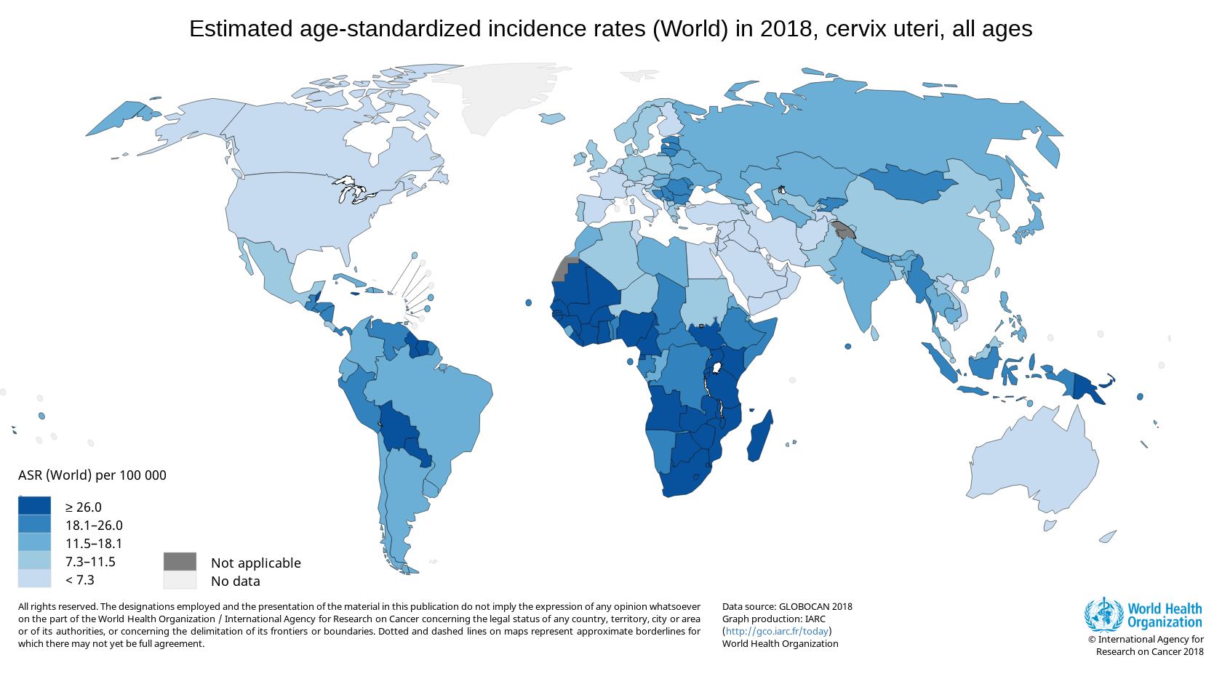
Cervical cancer – an avoidable cancer, but one with gross inequities between and within countries (Globocan 2018)
Each year: 570,000 incident cases & 311,000 deaths
Notes:
528,000 new cases
266,000 death
90 % of the deaths in LMIC
Cervical cancer is an unacceptable disease and the burden is still far too high in many countries, principally in middle and low income countries,
reflecting the many inequities across the world in terms of access to services.
High income countries have addressed the burden with organized screening programmes and now the low cx ca incidence can be maintained by the introduction of vaccines

Slide 3
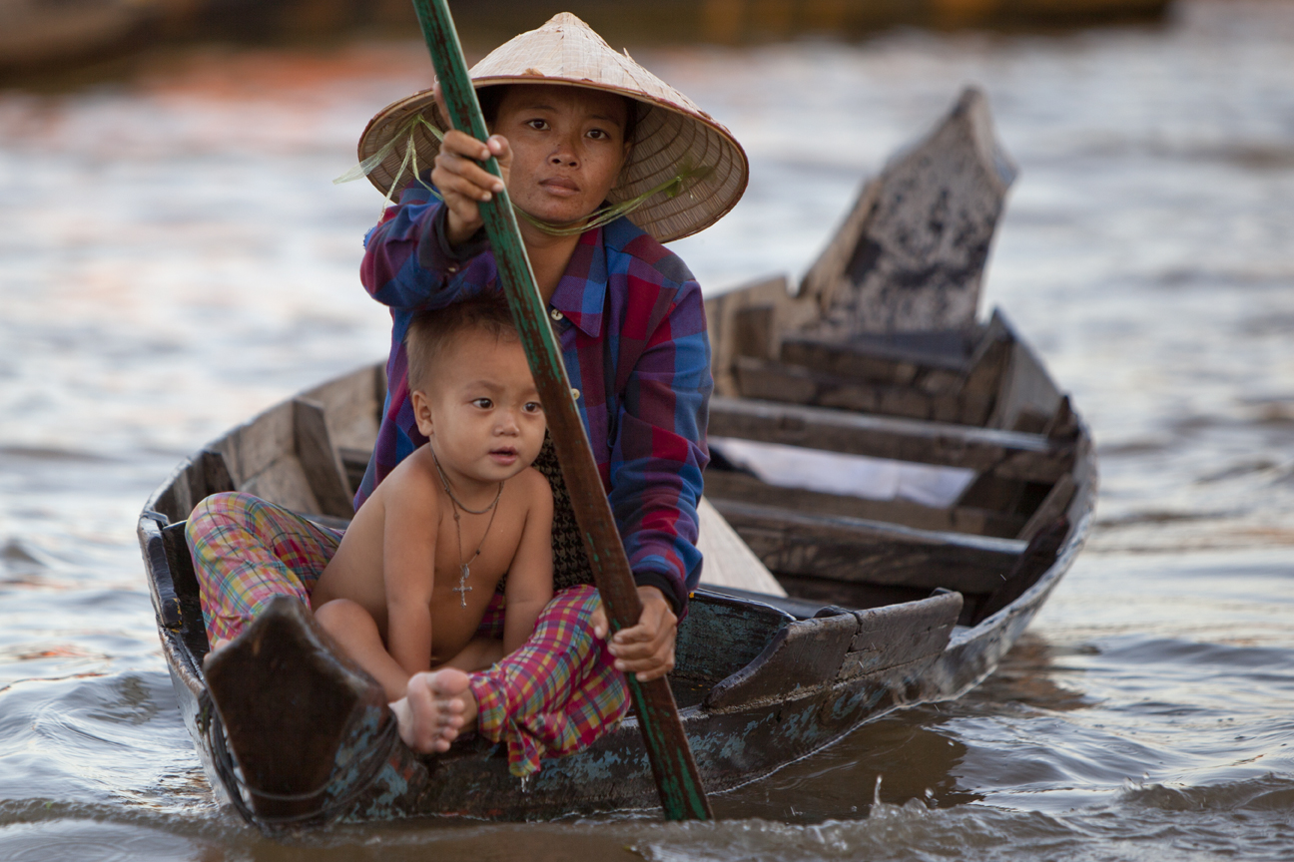
With kind permission of @Carolyn Taylor

Slide 4
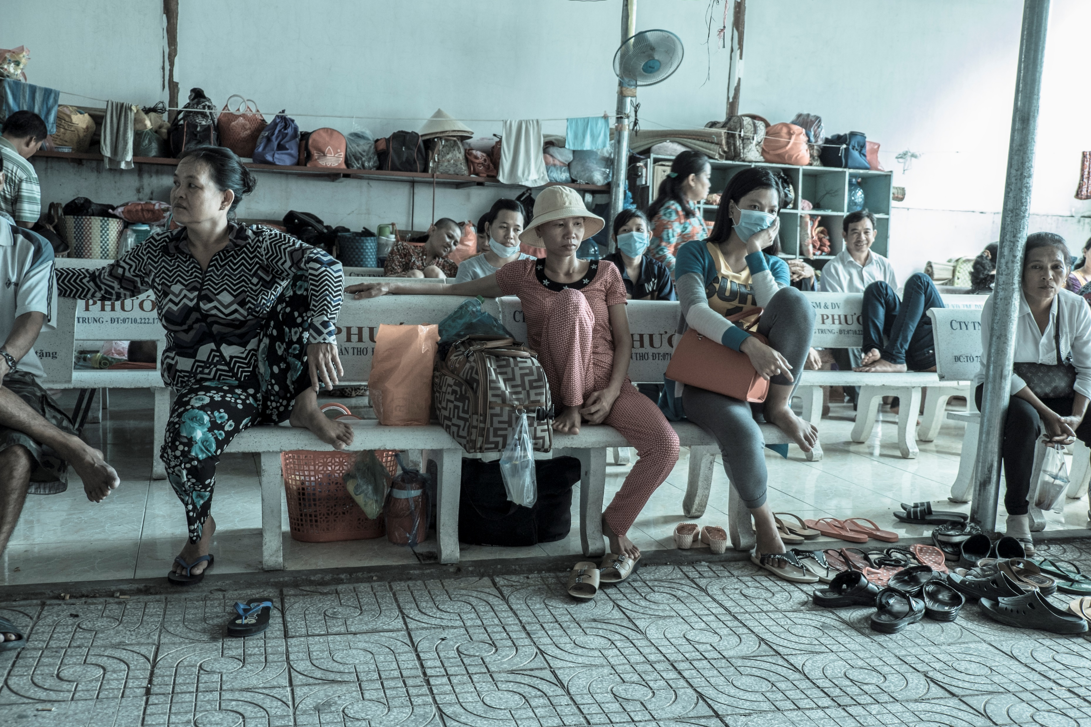
With kind permission of @Carolyn Taylor

Slide 5
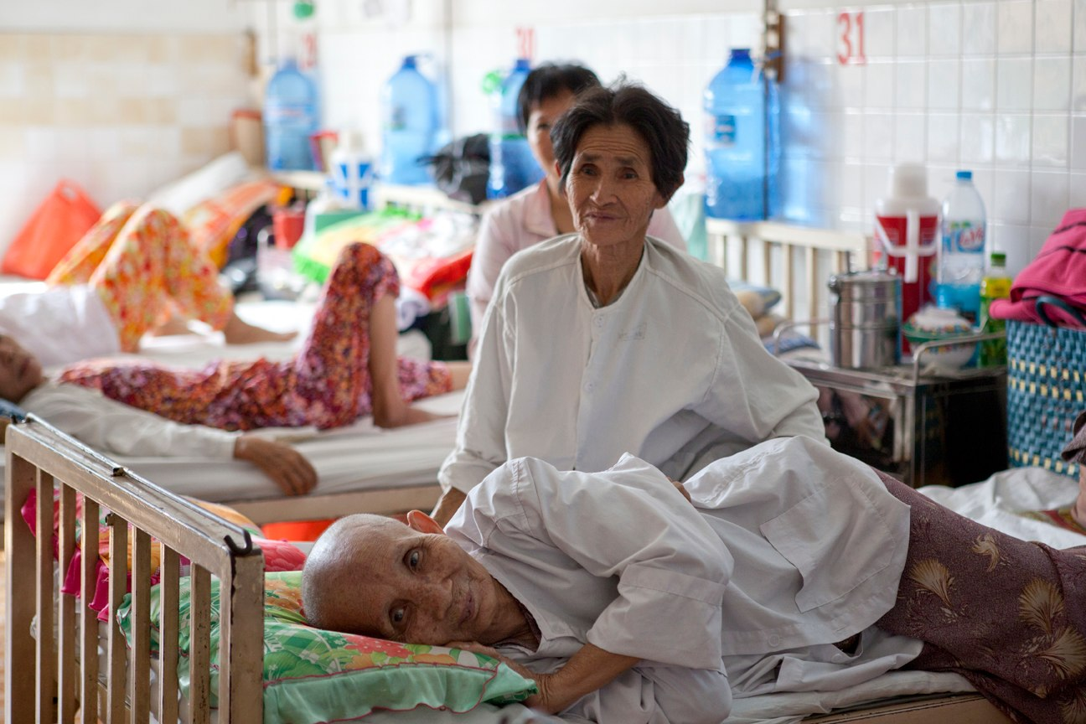
With kind permission of @Carolyn Taylor

Slide 6
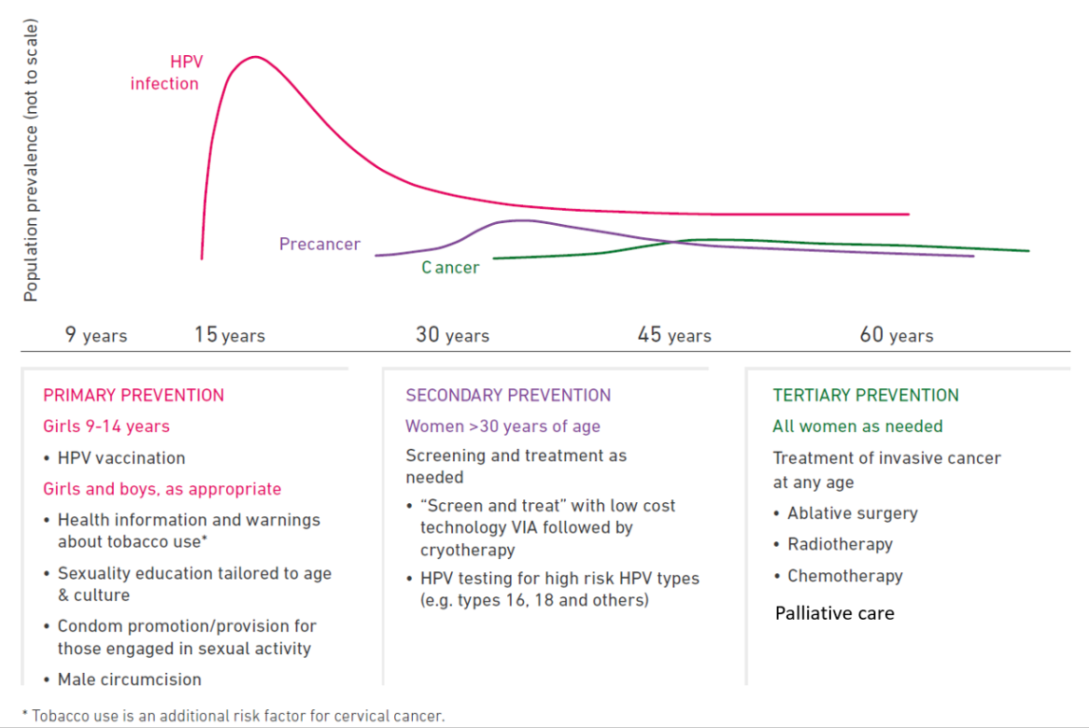
WHO life course approach to cervical cancer control
HPV / HIV co-infection
Women living with HIV are 4-5 times , more likely to develop cervical cancer!
Primary Prevention
Secondary Prevention
Women > 30 years of age
“Screen and treat” – single visit approach
Point-of-care rapid HPV testing for high risk HPV types
Followed by immediate treatment
On site treatment
Tertiary Prevention
Girls 9-14 years
HPV vaccination
Girls and boys, as appropriate
Health information and warnings about tobacco use
Sexuality education tailored to age & culture
Condom promotion/provision for those engaged in sexual activity
Male circumcision
All women as needed
Treatment of invasive cancer at any age and palliative care
Ablative surgery
Radiotherapy
Chemotherapy
Palliative Care
Global guidelines ✓ Global Indicators ✓ Global Cost-effectiveness recommendations ✓
Notes:
The strategic direction 2, highlights the 3 key WHO recommendations to be implemented at scale in countries based on a life course approach, as represented on this figure:
- HPV vaccination;
- Screening and treatment;
- Treatment of cancer and access to palliative care.
For vaccination, the vaccine group in WHO is currently looking at new evidence available to update the recommendation if needed, and to present findings to the next SAGE meeting
For screening and treatment: new recommendations are going to be published on thermal ablation and screening amog HIV positive women. The strategy will focus on the extensive implementation of one of the recommended algorithm: HPV testing followed by immediate treatment for women tested positive in a single visit approach
As more cancer will be identified in the context of an intensive screening campain, strengthen access to reatment and palliative care is essential

Slide 7
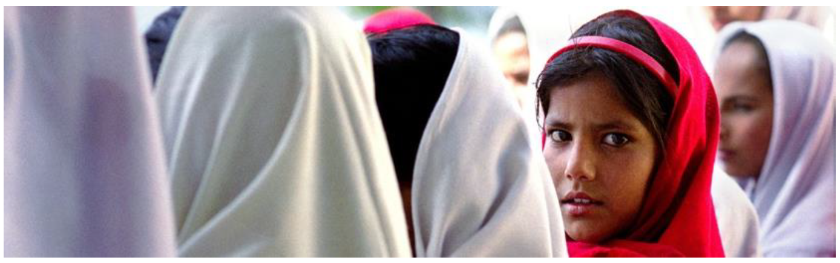

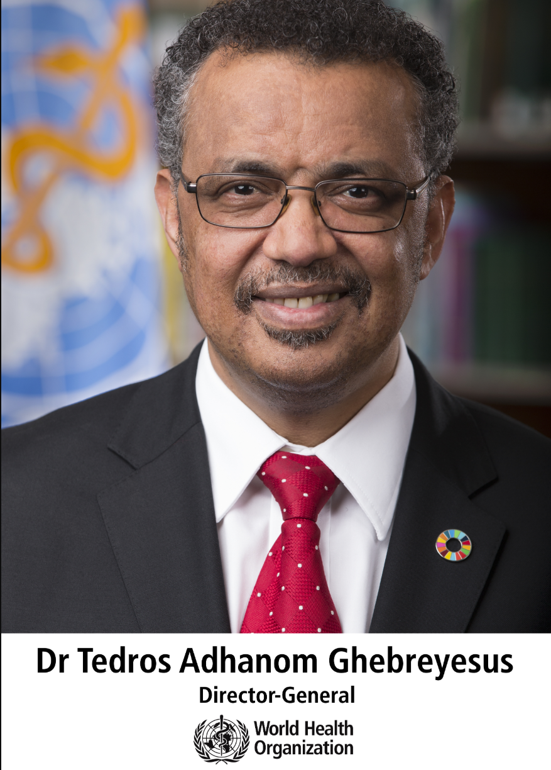
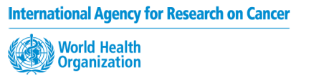


WHO Director Generals call to action
21st May 2018
“We have the tools to prevent, detect early and cure this disease. I am calling for coordinated action globally to confine cervical cancer to the history book”
Notes:
So the call to action made on 19 May by the WHO Director-General is critical to define a path forward and engage with partners and member states, to overcome the challenges and scale-up cost-effective interventions.
Coordinated action globally is needed to eliminate cervical cancer.
Already many partners have endorsed this call to action, as per the many logo you can see on this slide, but we are also reaching out to more partners to join forces.
As many partners are already working towards contributing to this goal, the key message of the call to action was that this should be done in a more coordinated manner in order to accelerate progress.
The WHO DG Recognized that several countries and UN agencies have already moved forward under the UN Global Joint Programme on Cervical Cancer Prevention and Control, however, he insisted that to succeed, we need everyone on board, and that we must expand our partnership to include anyone and everyone who can help us reach our goal.

Slide 8
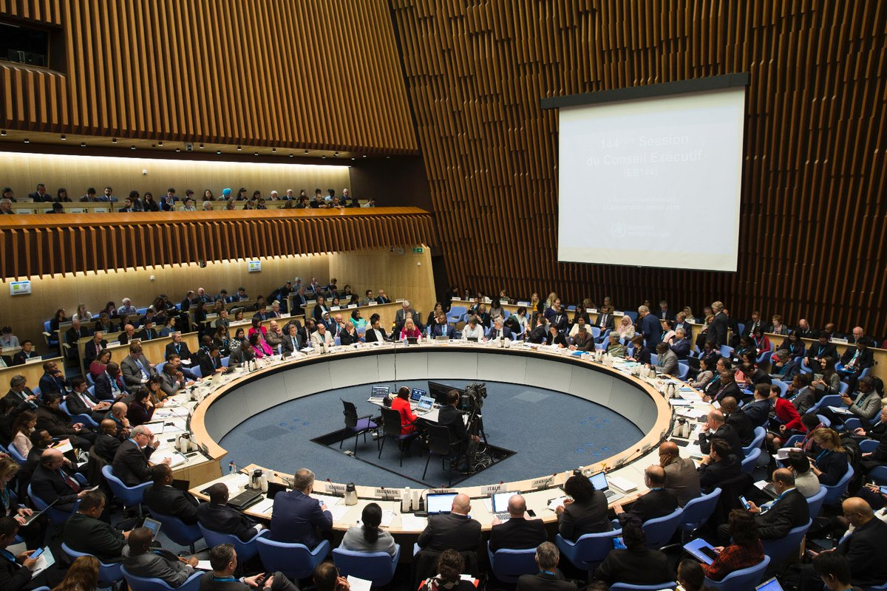
144th WHO Executive Board – 30 January 2019
More than 70 countries supported the decision for WHO secretariat to develop a:
2020-2030 Global Strategy towards the Elimination of Cervical Cancer
Public national commitments:
Australia; Zambia; Malaysia; Kenya; Bhutan; Rwanda; Canada
Photo credit: Chris Black

Slide 9
The emerging global strategy
2030 CONTROL TARGETS
VISION: A World Free of Cervical Cancer
THRESHOLD: < 4 cases of cervical cancer per 100,000 woman-years
4/100.000 means cervical cancer rates below that of rare cancers
90%
of girls fully vaccinated with HPV vaccine by 15 years of age
70%
of women screened with an HPV test at 35 and 45 years of age
90%
of women identifed with cervical disease receive treatment for precancerous lesions or invasive cancer
Focus on coverage for equitable access and outcomes – “leaving no one behind”
SDG 2030: Target 3.4 – 30% reduction in mortality from cervical cancer
The 2030 targets and elimination threshold are subject to revision depending on the outcomes of the modeling and the WHO approval process

Slide 10
Cervical Cancer Elimination: Conceptual Framework
Current vaccination and screening
90:70:90 is challenging for us, but African communities stand to uniquely benefit from taking up the elimination challenge”
Brazzaville consultation May 2019
Very intensive screening and vaccination
Cervical cancer cases/100,000
Intensive vaccination
2020
2030
2060
2120
Notes:
Question: What will different models tell us when and how global cervical cancer elimination can be reached under the most optimistic and aspirational assumptions?

Slide 11
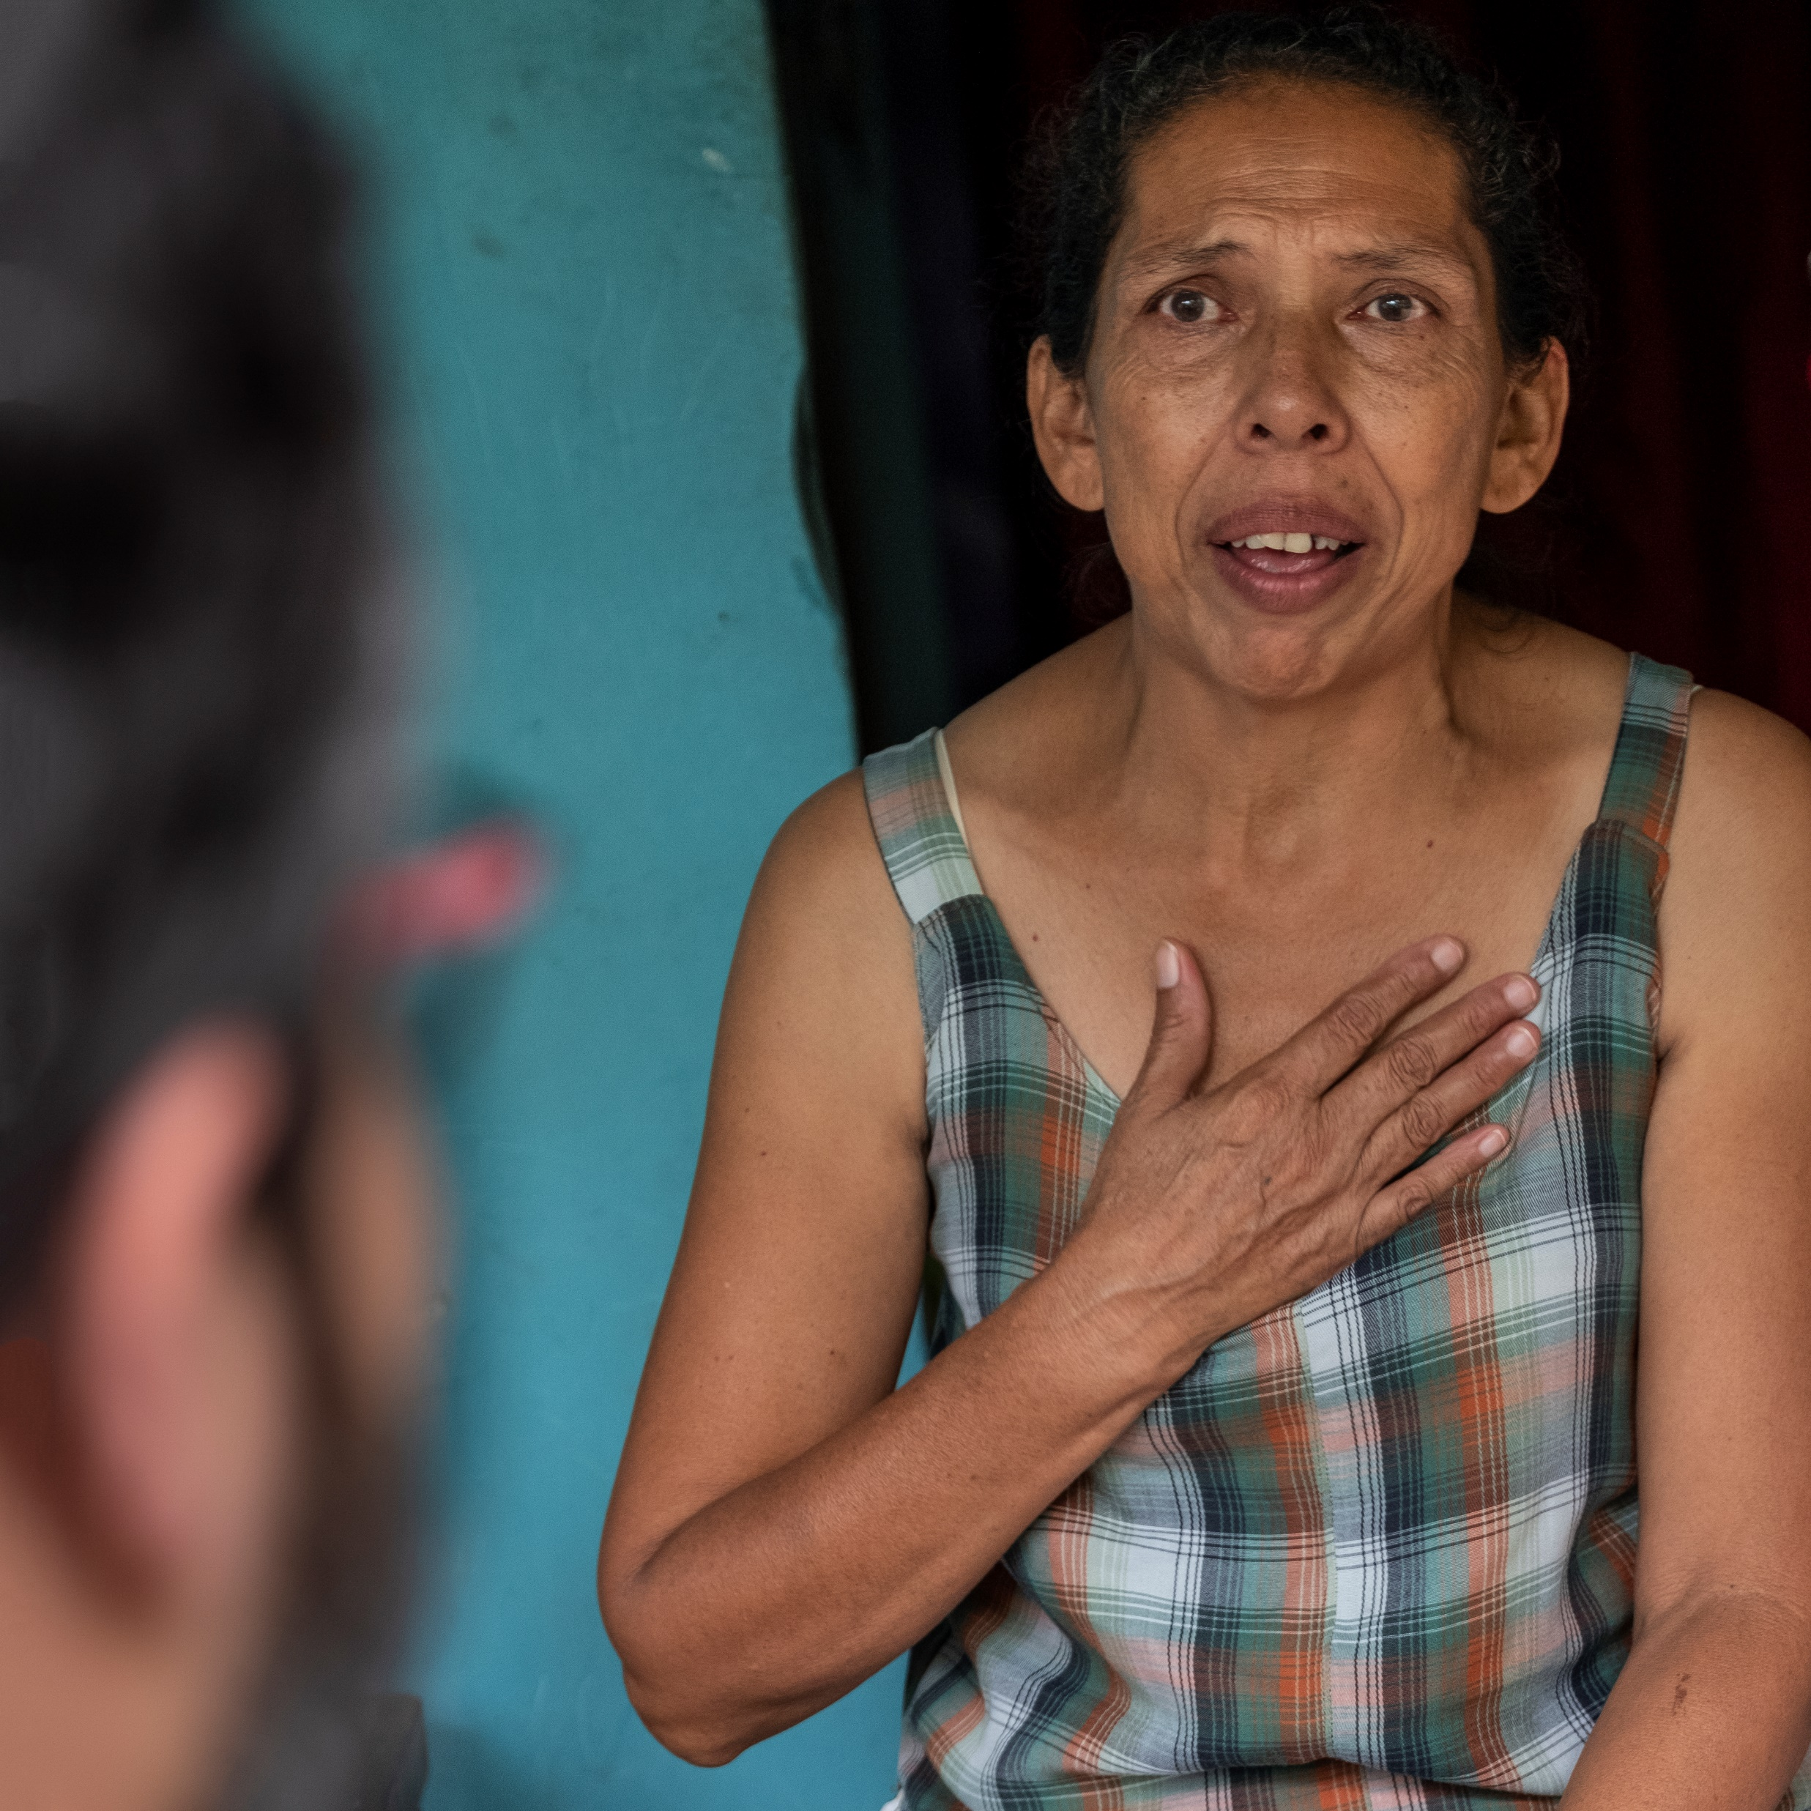
With kind permission of @Carolyn Taylor

Slide 12

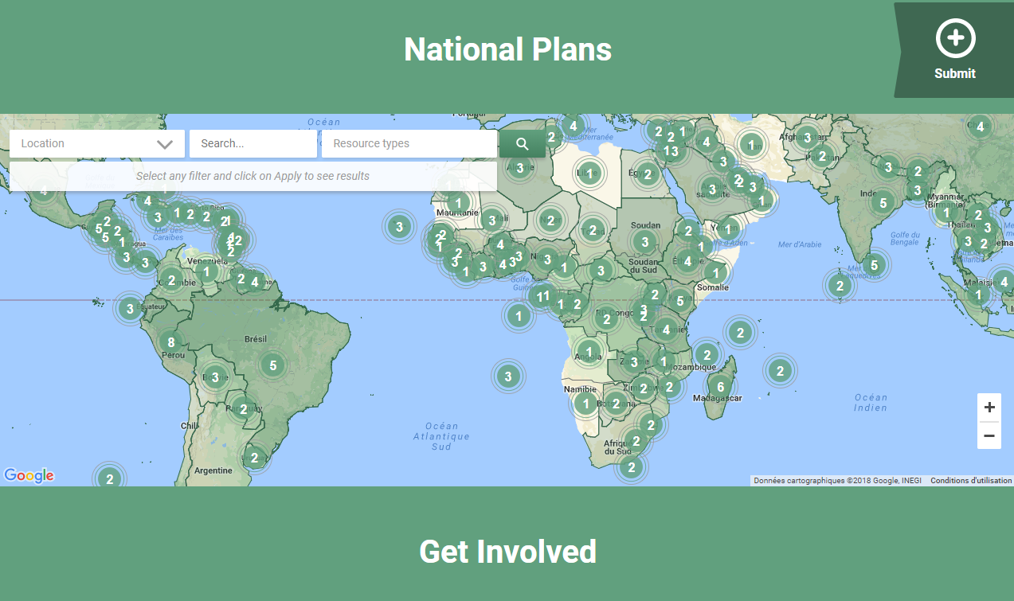

Since 2011, we have been advocating that all NCCPs should be in the public domain
National Cancer Control Plans collated on portal:
In 2013: 91 NCCPs from 42 countries
In 2015: 115 NCCPs from 50 countries
In 2018: 224 NCCPs from 93 countries
158 countries with NCCP or NCD plans

Slide 13
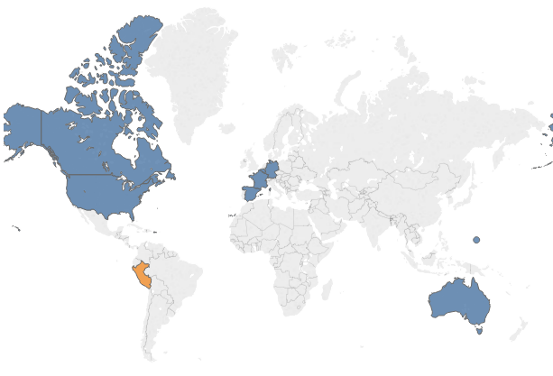
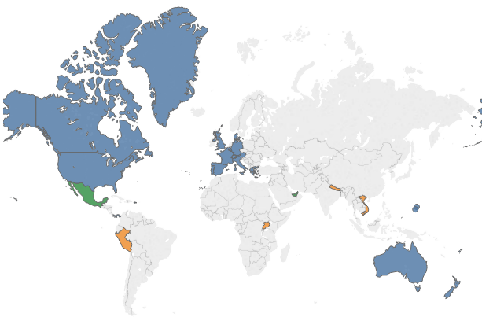
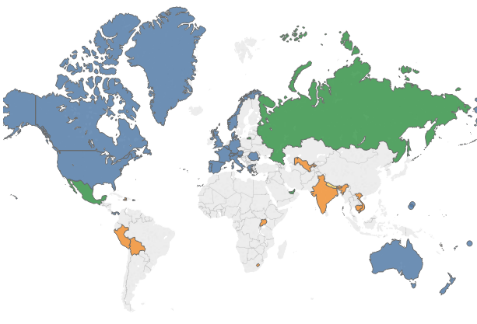
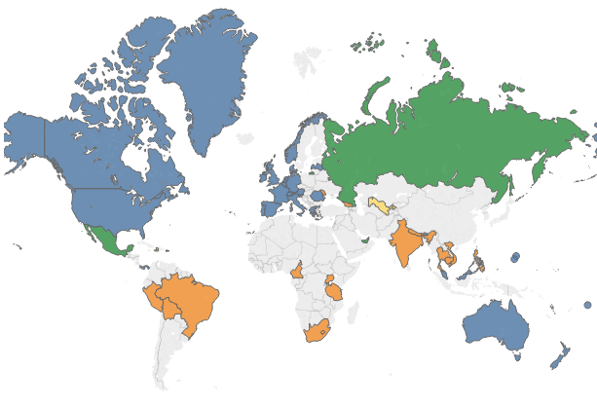
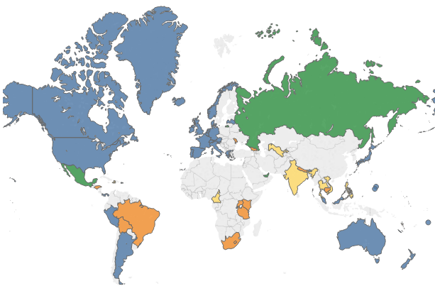
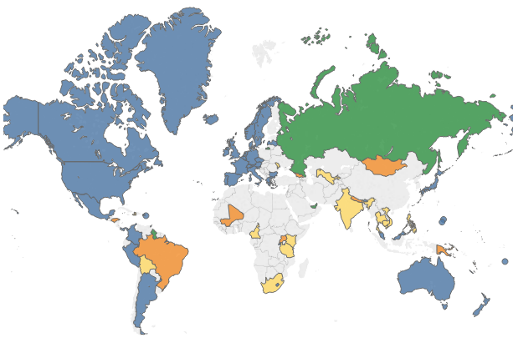

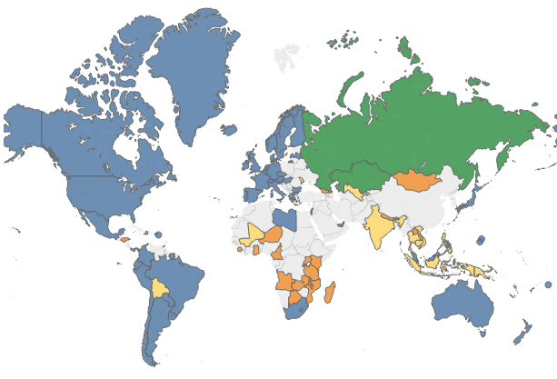
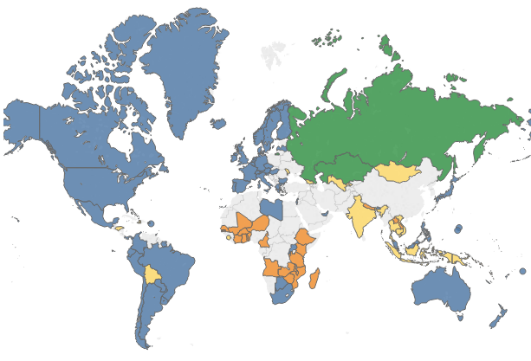

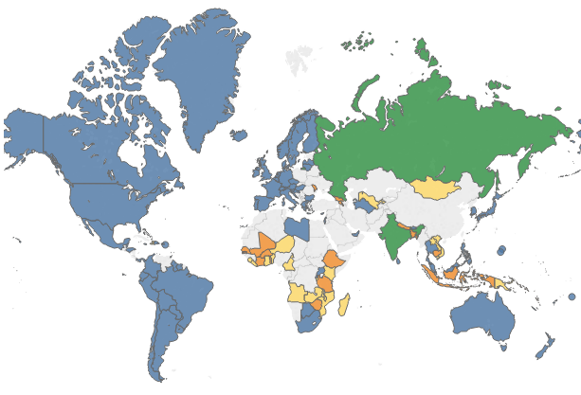




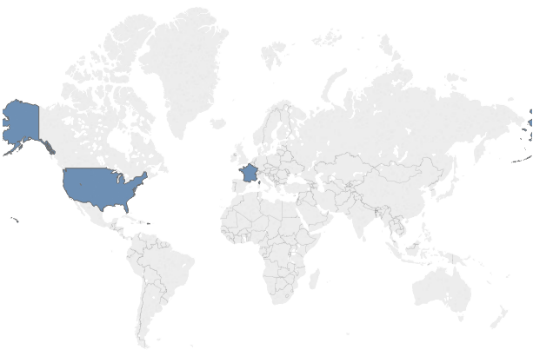
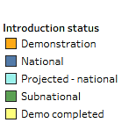
Global HPV Vaccine Introduction
Year:
2007
2008
2009
2010
2011
2012
2013
2014
2015
2016
2017
2018
2019
2020
2021
2006
*
* Decision pending on national introduction
Notes:
START WITH CLICK
Map:
Pic position:
Width – 15.4
Height – 12.32
Offset X – 1.42
Offset Y – 0.67
Crop position:
Width – 9.44
Height – 6.43
Left – 1.34
Top – 0.73
Year:
Position:
Horizontal position: 0
Vertical position: 2.58
How to update after first year is set up:
Insert picture (make sure format toolbar is open)
Change picture’s crop position to match above (make sure you do crop first)
Change picture position to match above
Add ‘appear’ effect to map picture and change its duration to 2 seconds; mark ‘appear after previous’
Copy year text box and paste; change year to following year
Change year text box position to match above
Add ‘appear effect’ to year and make sure it comes after the map in the animation pane; mark ‘appear with previous’ and make sure its duration is 2 seconds
Test the animations
Repeat for each year

Slide 14
Thank you
Dr Julie Torode
Director, Special Projects
torode@uicc.org
www.uicc.org

