Slide 1
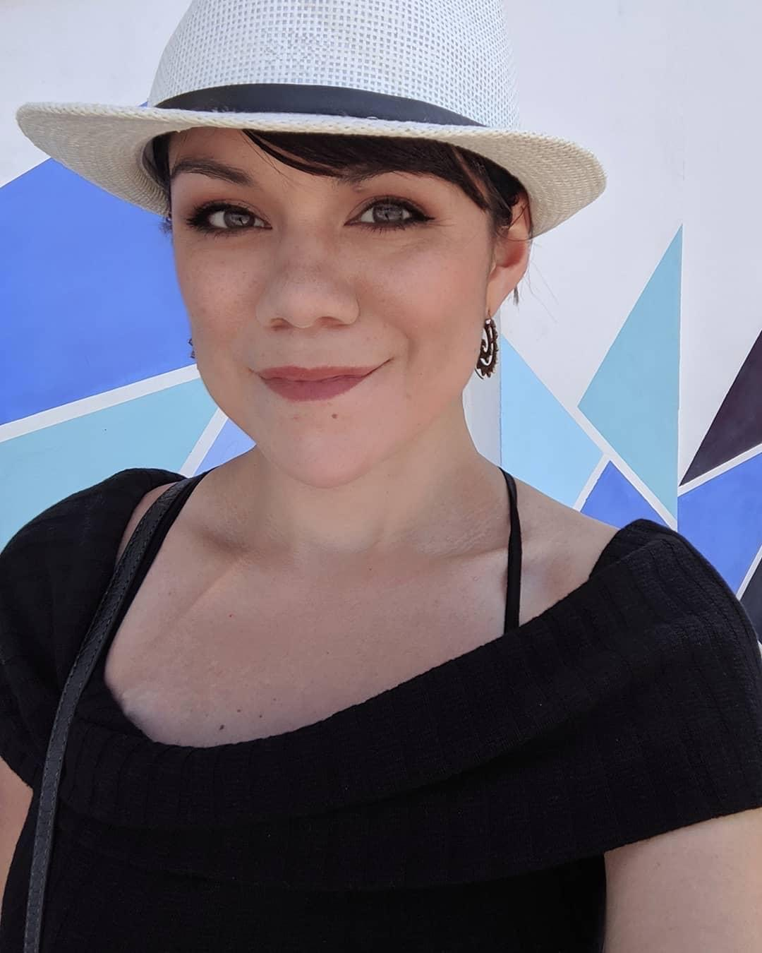
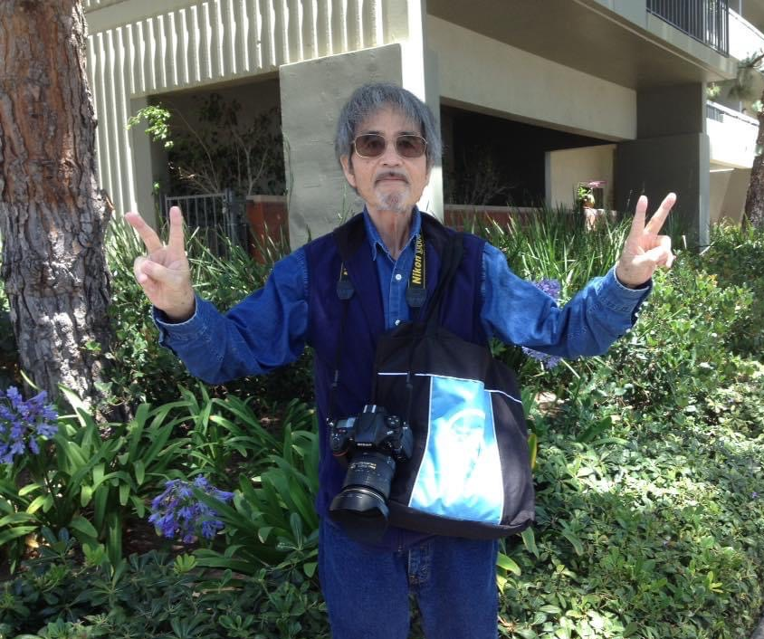
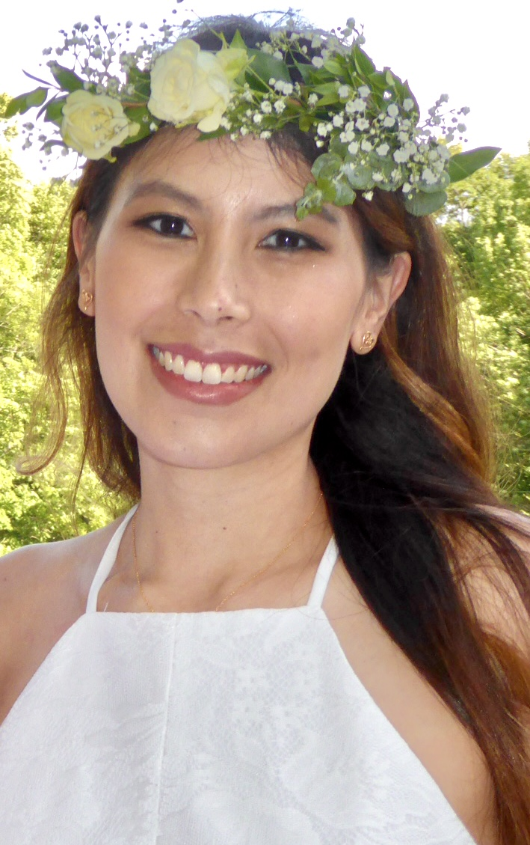
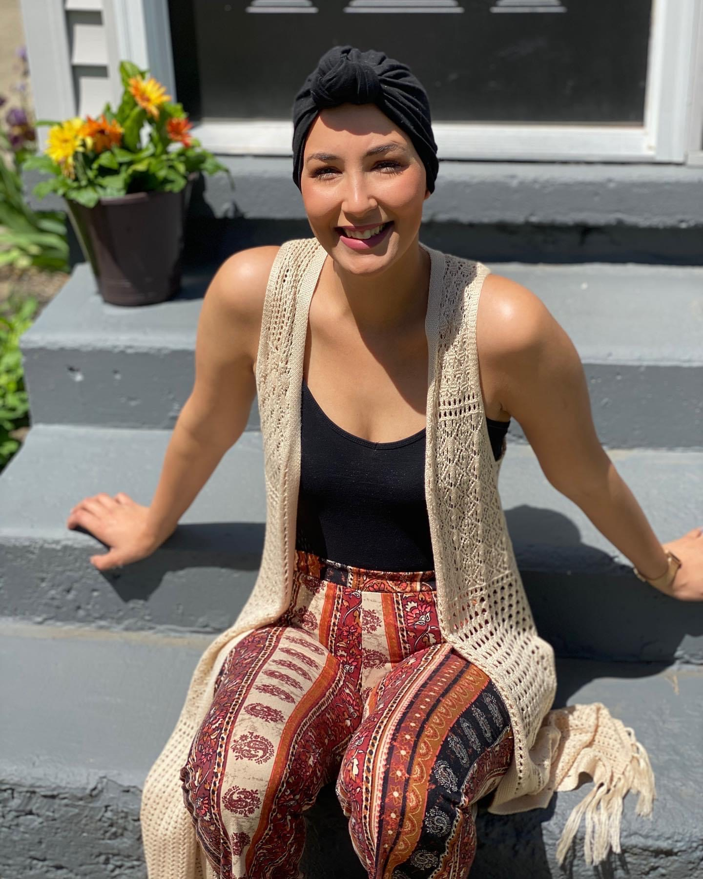
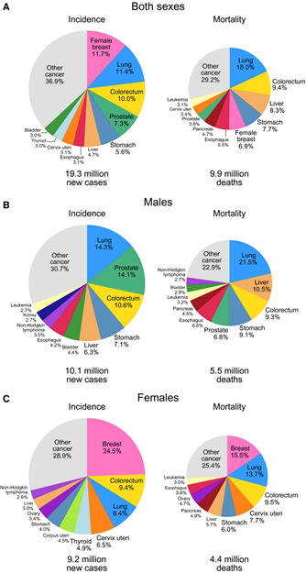
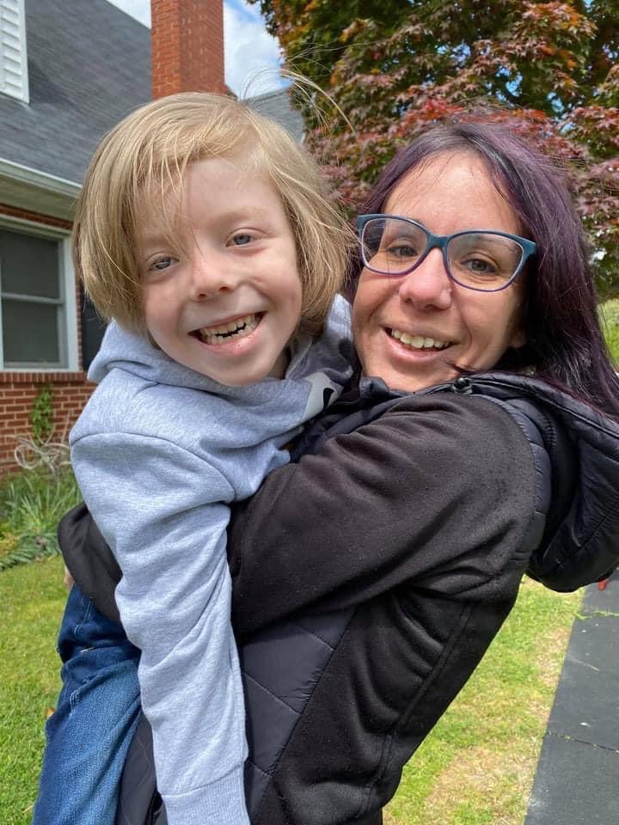
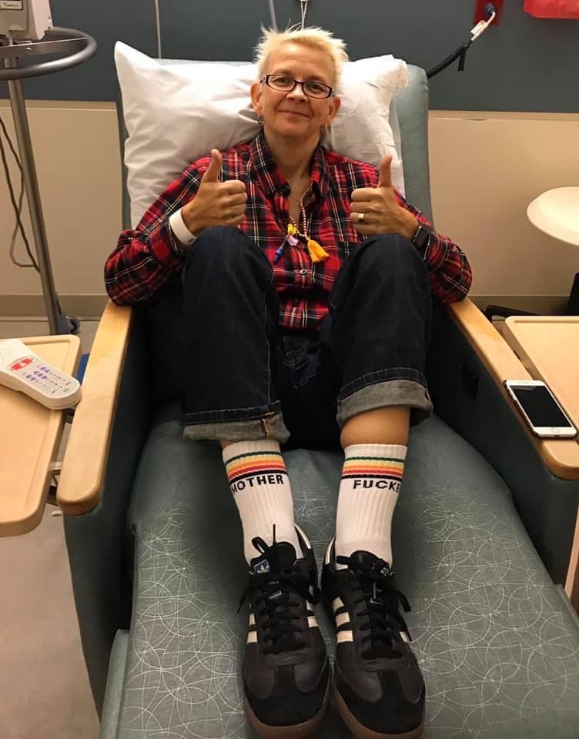
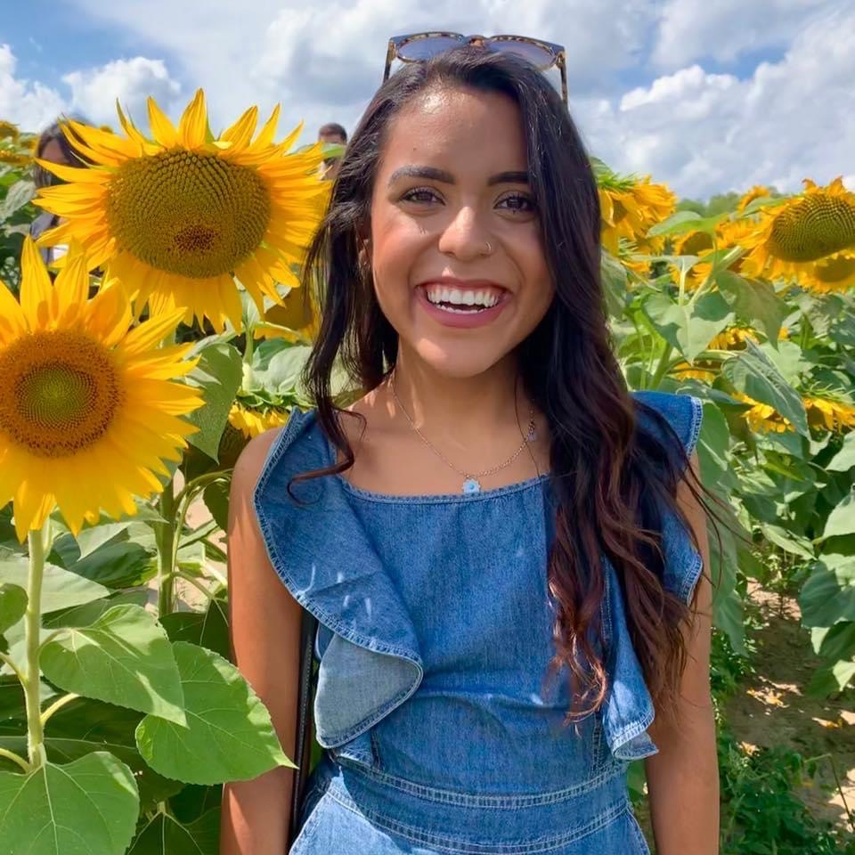
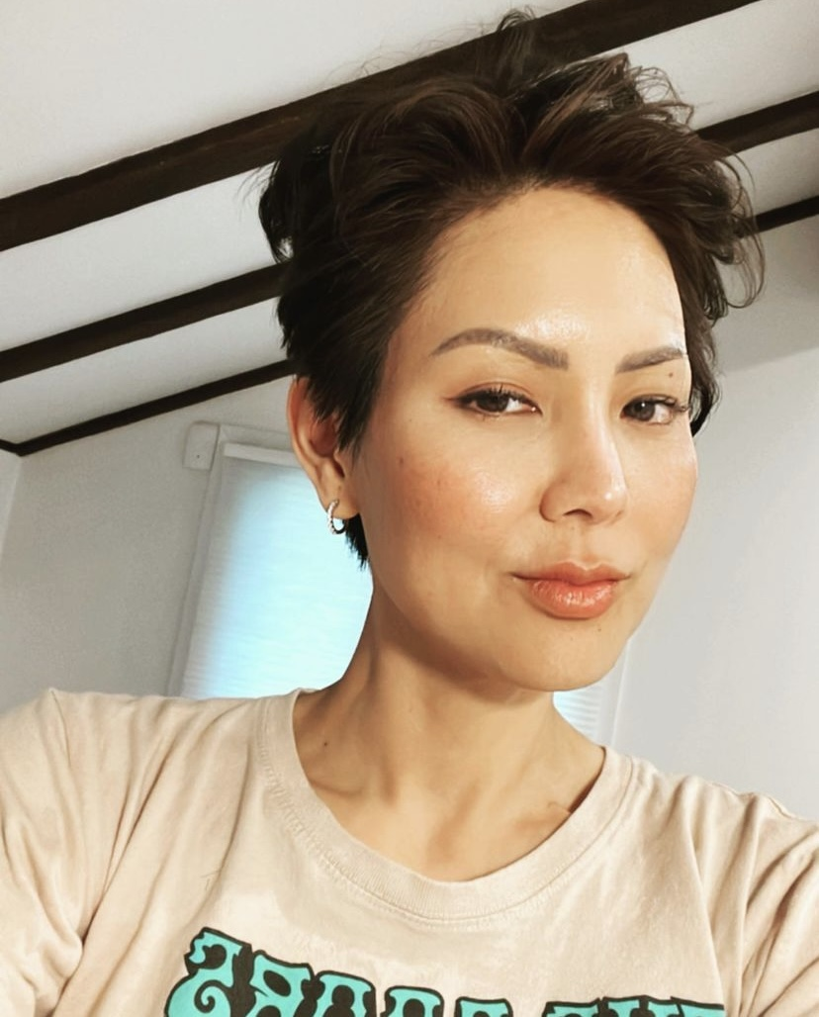
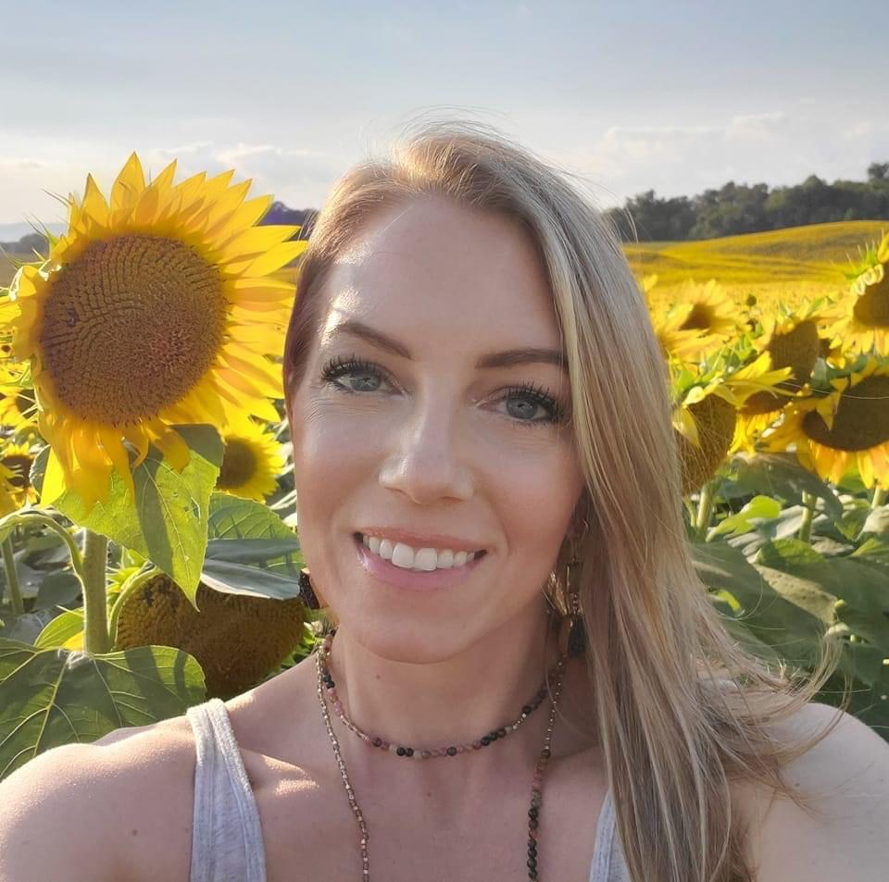
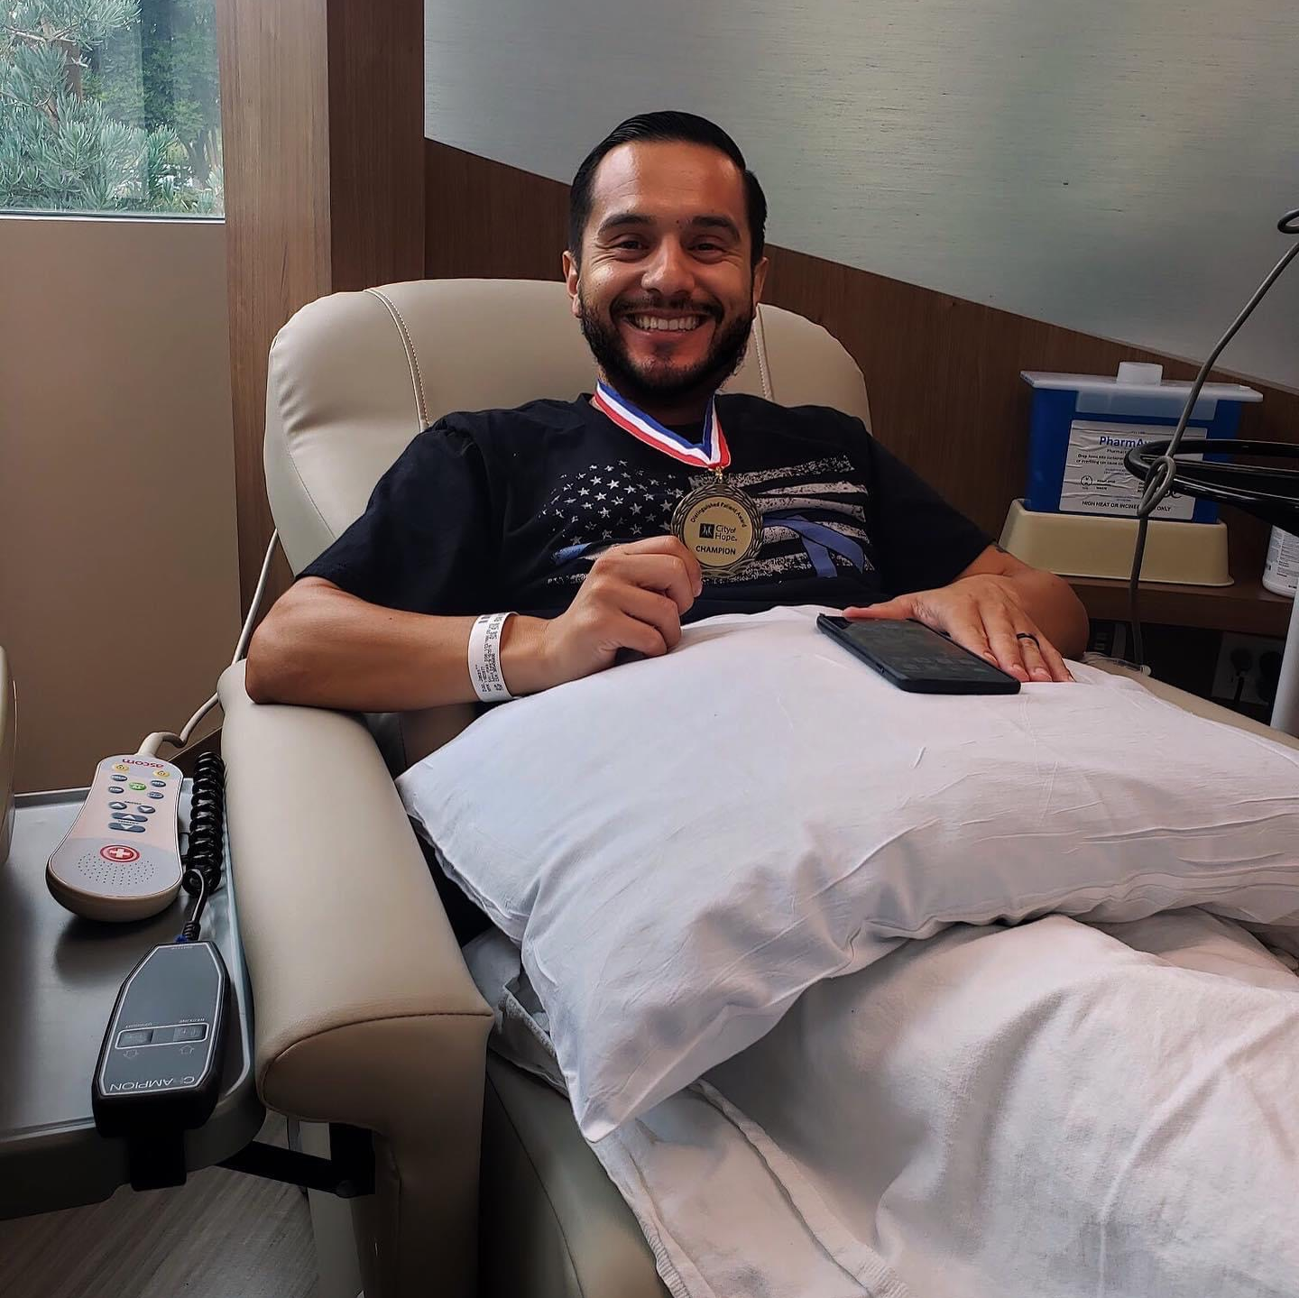
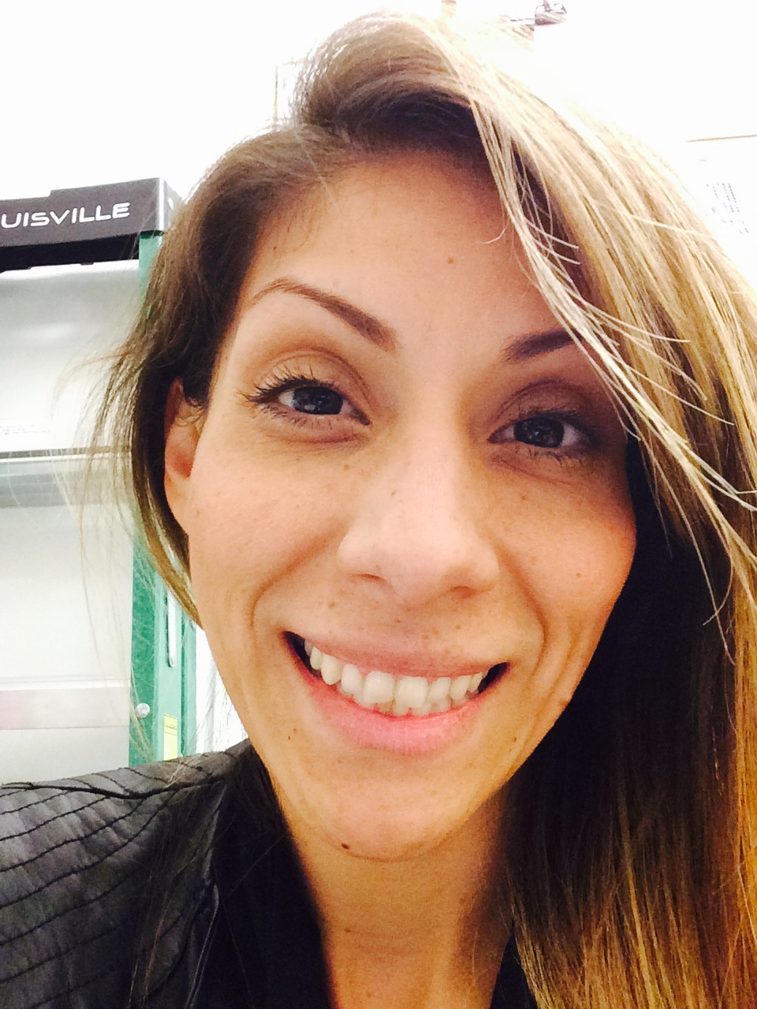
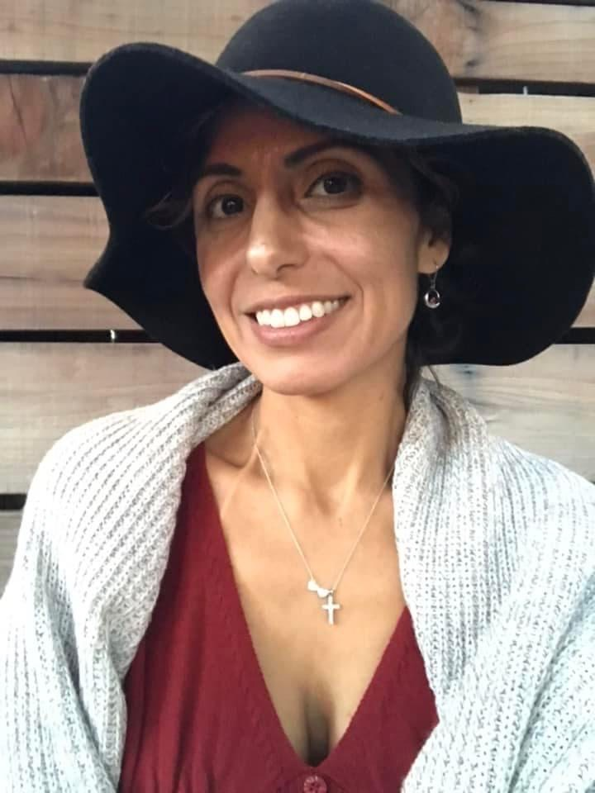
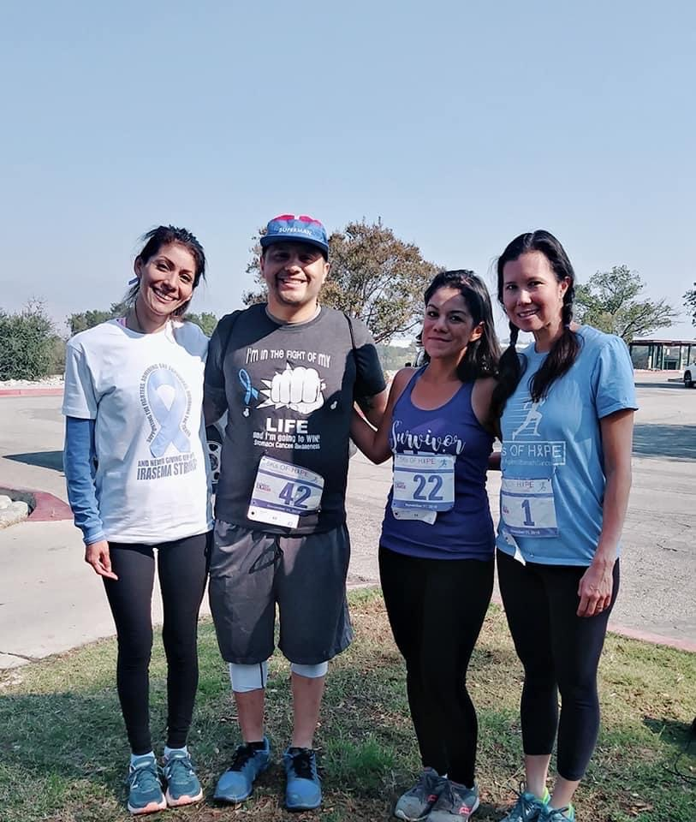

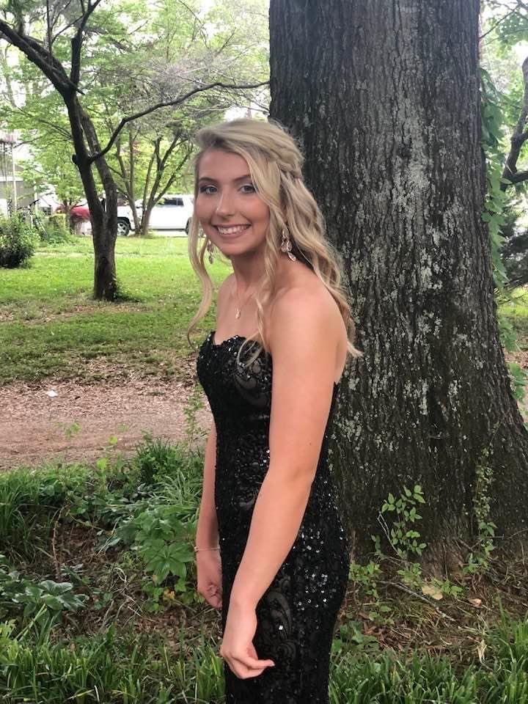
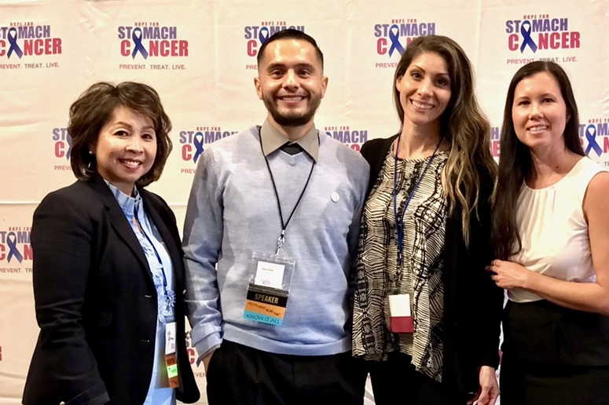
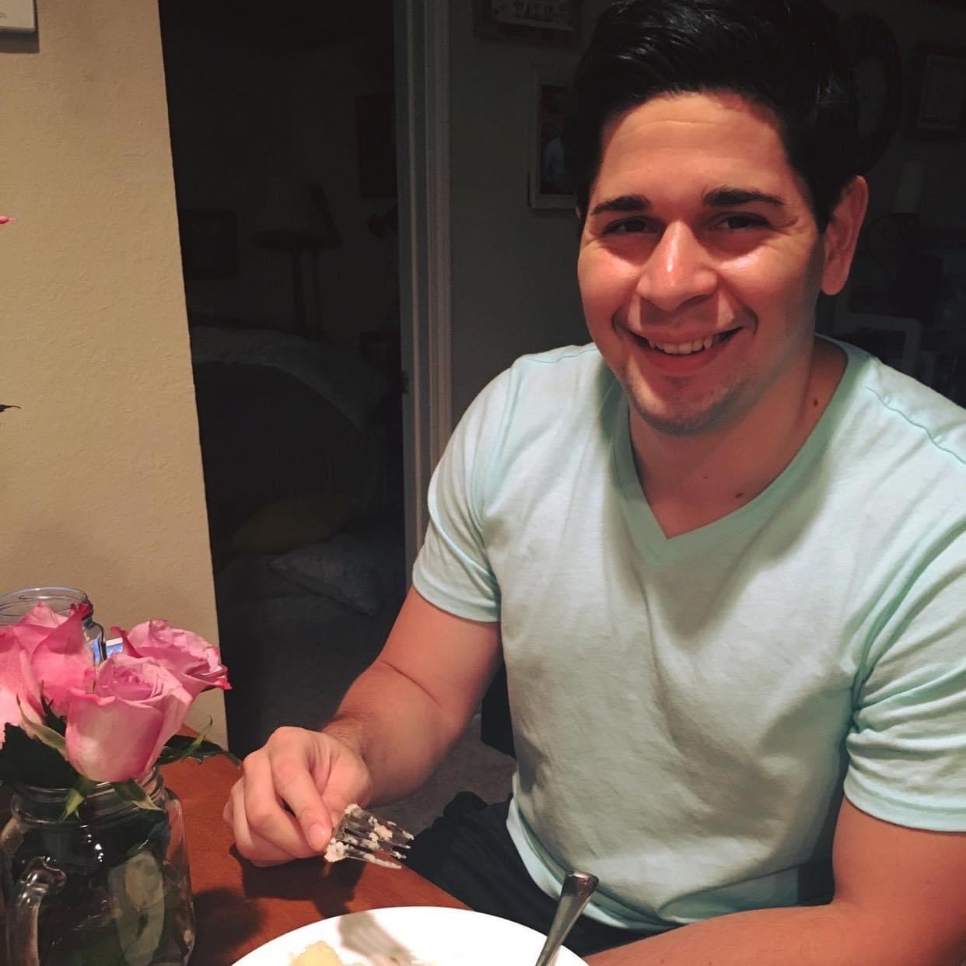
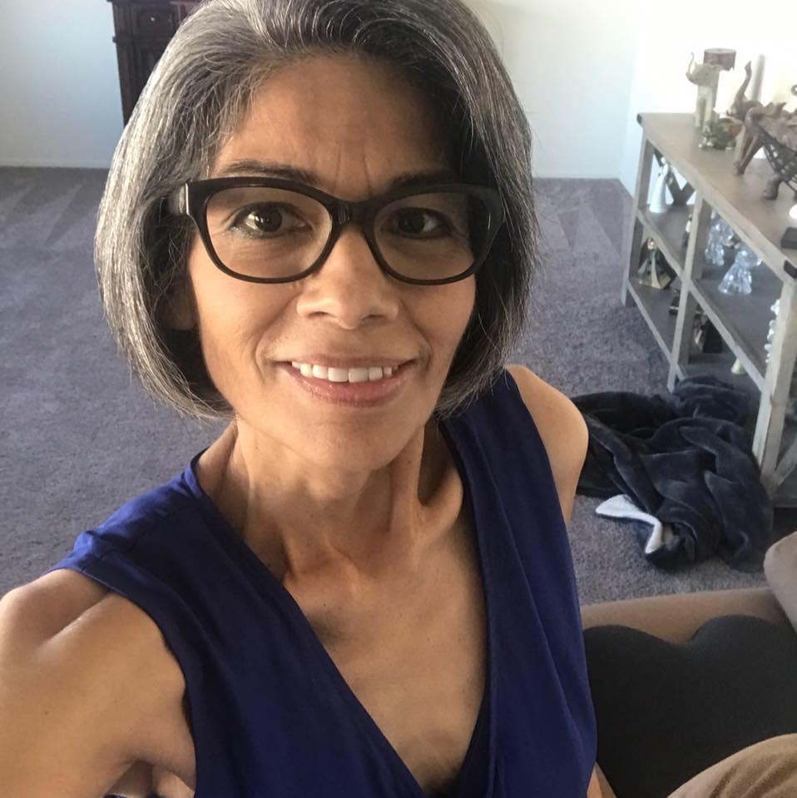
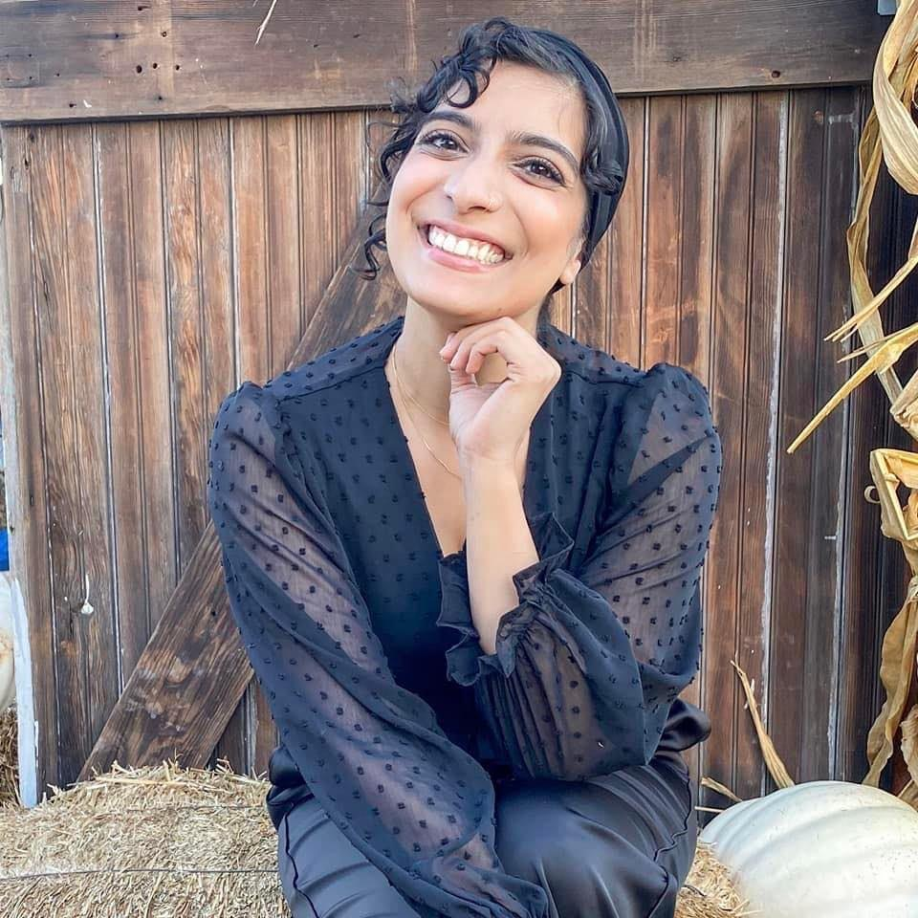

SURVIVING Stomach Cancer and LIVING to raise AWARENESS
Stomach Cancer Stats 2022:
This is Stomach Cancer
26,380 new cases in the United States
11,090 not expected to survive
Global Problem:
6th most common cancer
4th deadliest
Source: American Cancer Society 2022 GLOBOCAN2020
Irasema Partida, Survivor and Advocate
Lexy diagnosed at age 27
Stage 2B Stomach Cancer Survivor
(2015-NED)
Stage 1 Breast Cancer Survivor
(2020-present)
Bio
Branny diagnosed at age 37
Irasema was diagnosed with Stomach Cancer at the age of 34, she has been NED since 2016. As part of her healing process Irasema found herself needing to give back to the community by sharing her story and raising awareness.
Shigeo diagnosed at age 71
Katrina diagnosed at age 25
Hope for Stomach Cancer
In 2016, Irasema met Aki Smith, the founder of Hope for Stomach Cancer, a 501©(3) non-profit organization based out of Southern California.
Mission: To provide support, resources and awareness to those affected by stomach cancer. Through research, early detection and prevention, we serve the stomach cancer community helping to save lives and working to find a cure.
Jay diagnosed at age 54
Jennifer diagnosed at age 26
Camilla diagnosed at age 39
Stomach Cancer Sisters
Aby diagnosed at age 27
In 2020, Irasema met Aby Mejia and Lexy Patton who were both in their 20’s and diagnosed at Stage IV. They began connecting with other young women battling Stomach Cancer, those women led to the creation of the Facebook group called Stomach Cancer Sisters. Although both Aby and Lexy have passed, their legacy lives on with the Stomach Cancer Sisters community.
Mission: To raise awareness about Stomach Cancer in the young adult population. This space was created for young women to share their journey’s, to ask for and receive advice. No topics are off limits. Together we are STRONGER!
Brittany diagnosed at age 36
Janeth diagnosed at age 39
Jason diagnosed at age 32
Irasema diagnosed at age 34
Santiago diagnosed at age 30
Volunteer Work:
Hope for Stomach Cancer Annual Symposium
5K’s of HOPE
GI ASCO 2019 & 2022
IGCC 2022
Carmen diagnosed at age 53
Uroosa diagnosed at age 27
Jewell diagnosed at age 16

