Slide 1
AACR Project GENIE Solid Tumor Clinical Abstraction Data Model Development RFP July 31, 2024 Contact Person: Jennifer Hoppe Jennifer.hoppe@aacr.org

Slide 2
Statement of confidentiality
As more fully described later in the Terms & Conditions of this document, the Supplier must treat this RFP as confidential and must not disclose any aspects of it to any party other than Supplier’s employees with a need to know, and who are informed of this confidentiality restriction. This obligation does not apply to information that is in the public domain through no breach of confidence by the Supplier (including its employees and agents) or information that is available from a source other than AACR Project GENIE without a breach of confidence with AACR Project GENIE.

Slide 3
Overview
AACR Project GENIE is a publicly accessible cancer registry of real-world clinico-genomic data assembled through data sharing between 22 leading international cancer centers. The registry aggregates, harmonizes, and links clinical-grade, next-generation cancer genomic sequencing data with clinical outcomes obtained during routine medical practice from nearly every cancer patient treated at these institutions. The consortium and its activities are driven by openness, transparency, and inclusion, ensuring that the project output remains accessible to the global cancer research community for the benefit of all. We see the GENIE data providing another knowledge turn in the virtuous cycle of research, accelerating the pace of drug discovery, improving clinical trial design, and ultimately benefiting cancer patients globally.
In 2022, GENIE launched the GENIE Data Model Development Project. GENIE is developing a comprehensive pan-cancer solid tumor clinical data model that can be used for both prospective and retrospective clinical data collection. Upon completion, GENIE will make the data model freely available to the oncology community as a resource. A team of 10-12 experts (clinicians, data scientists, oncology researchers, patient advocates, computational scientists) have contributed to the development of the framework of the model and the clinical instructions/directives for manual curation. We now are soliciting proposals from vendors who can assist us designing, building, and implementing a flexible technical solution that will support the infrastructure for data integration, storage and analysis, ensuring the scalability and adaptability of the system to meet future needs.
We have identified your organization as being a potentially important vendor for this project and would like to gain a deeper understanding your assets and capabilities to assist us in this project. We would also like to gain a better understanding of how you would approach this project, and what additional recommendations you would have for us to consider in further developing this project with you. We further invite you to make a proposal including costing for the support of this project.
The remaining slides provide additional details about this project and what we believe are critical needs for its success.

Slide 4
RFP Timeline and Process
Scheduled Activity | Responsible | Date
RFP Distribution | AACR Project GENIE | June 11, 2024
Intent to Respond due | Suppliers | completed
Vendor Questions Template Submission | Suppliers | completed
Vendor Question Responses | AACR Project GENIE | July 31, 2024
Vendor Proposal Submission | Supplier | September 9, 2024
Scheduled Vendor Defense Presentations | AACR Project GENIE | September 9 - October 1, 2024
Anticipated Award | AACR Project GENIE | October 7, 2024

Slide 5
Introduction
AACR Project GENIE is building a pan-cancer GENIE Solid Tumor Clinical Data Abstraction Model (the “Model”) to support its internal projects.
The Model will serve as both a tool and a guide for defining and gathering patient data from electronic health records (EHRs) and associated documents or sources for the purposes of determining patient treatments and outcomes.
The Model will allow for the collection of oncology data elements following recommended standards for the structure and content of health record information across use cases and users. The goal of the Model is to facilitate the quality and the consistency of collection of clinical health and oncology-specific data across different health systems. Designed to establish a common language and framework, the Model will facilitate patient care and support research efforts by providing a structured framework for analyzing data collected on the entire duration of a cancer patient's journey as well as across different patient cohorts.

Slide 6
12 Required Cancer Types
Prostate*
Melanoma*
Bladder
Liver
Kidney
Ovarian
Breast*
CRC*
Glioma*
Lung* – NSCLC and SCLC
Pancreas*
Gastric/Stomach*
*priority cancers in green

Slide 7
AACR Model Clinical Areas of Focus
Diagnosis:
Patient-level diagnosis-related variables for all cancer types
Treatment:
Patient-level treatment-related variables for all cancer types
Patient-level surgery, medications, etc.
Response / Outcomes:
Patient-level variables to assist with calculating treatment response and outcomes (OS, PFS, etc.)
Social Determinants of Health:
Patient-level variables to assist with capturing SDoH both at the individual/patient and at the census tract level.

Slide 8
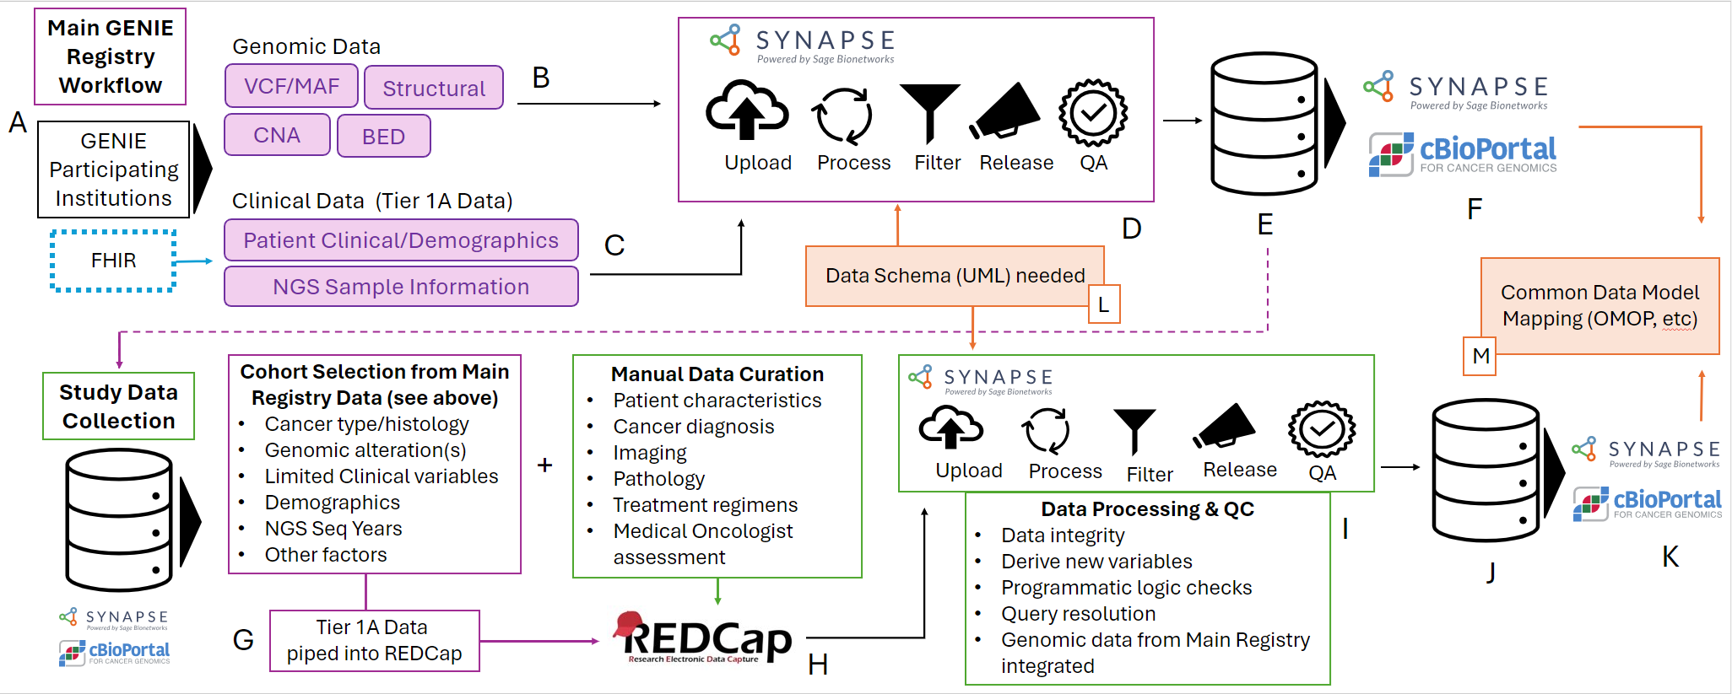
GENIE Data Process/Workflow

Slide 9
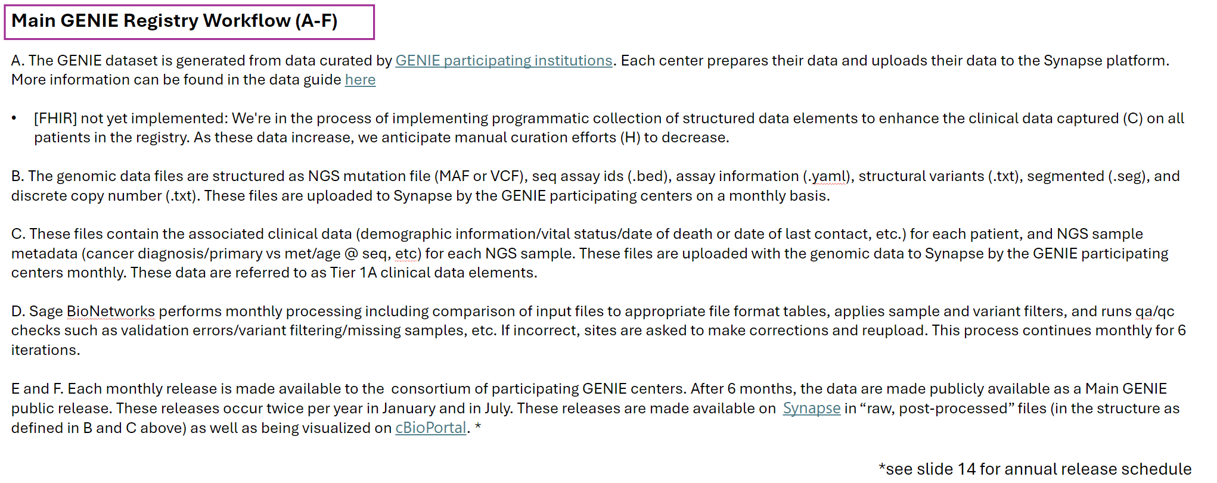
GENIE Data Process/Workflow (1)
* See slide 13 for annual release schedule

Slide 10
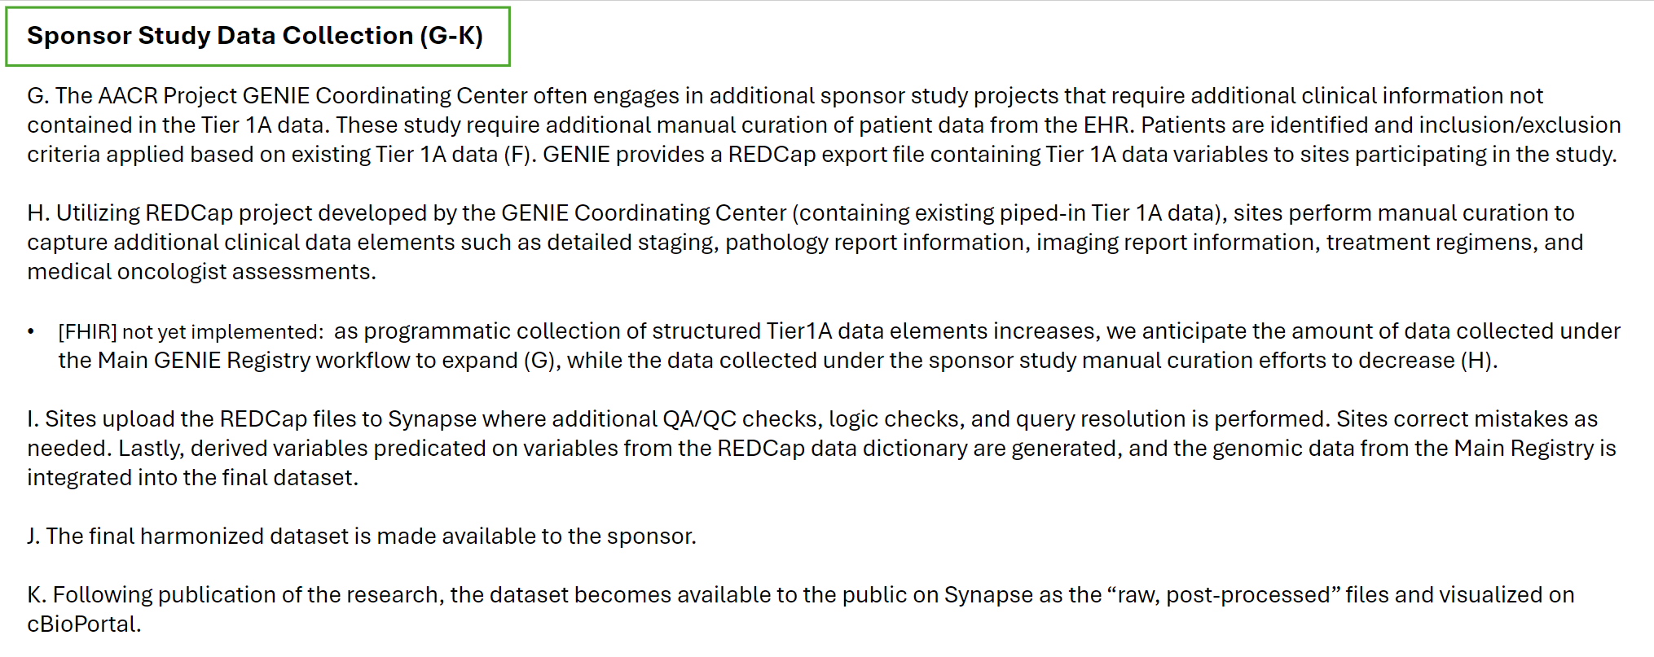
GENIE Data Process/Workflow (2)

Slide 11
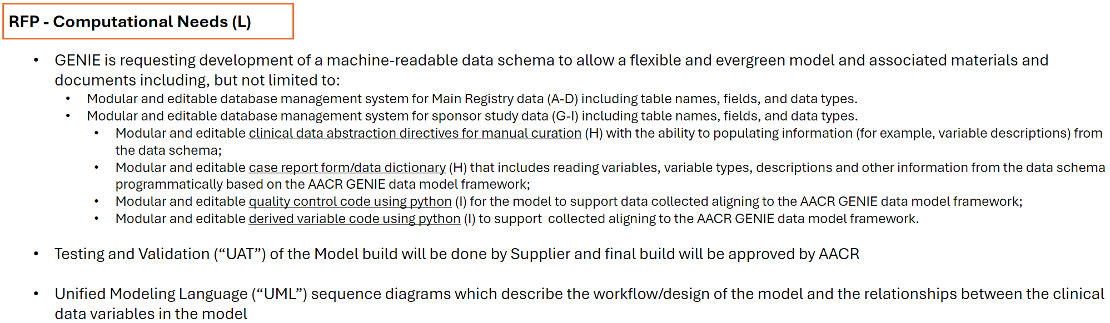
Requested Services/Deliverables

Slide 12
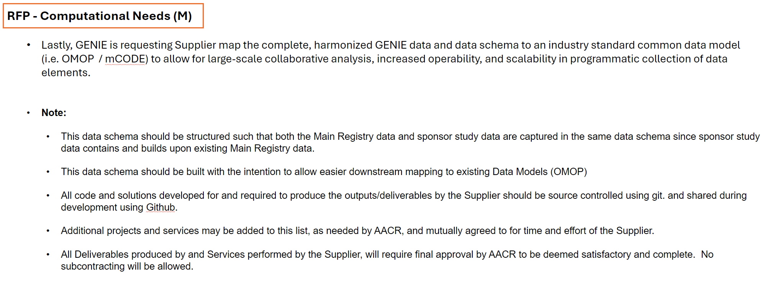
Requested Services/Deliverables (2)

Slide 13
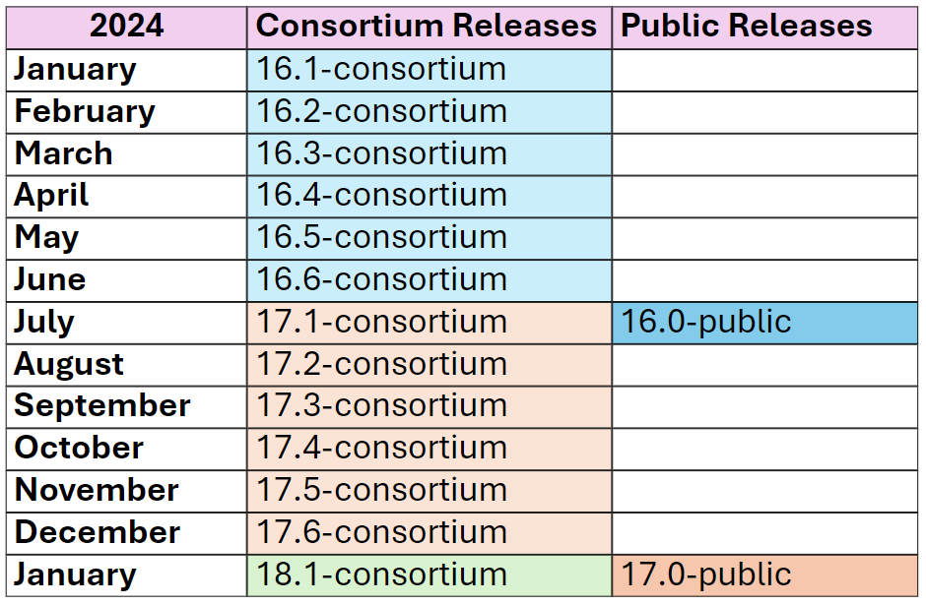
GENIE Data Release Schedule

Slide 14
Vendor Requirements
The vendor must be able to perform all services in-house without subcontracting for any component of the services or deliverables.
Selected vendors will develop a formal presentation detailing the approach to the requested services and deliverables.
AACR Project GENIE may select more than one vendor to perform the requested services and provided deliverables. Selected vendors must be willing to collaborate with other vendors are part of the data model development project.

Slide 15
Terms and conditions
Restrictions on Contact
All contact and questions about this process must be made through the AACR Project GENIE representatives identified below:
Jennifer Hoppe
Clinical Data Manager, AACR Project GENIE
Jennifer.hoppe@aacr.org

Slide 16
Terms and conditions (2)
Confidentiality and Ownership
This RFP is both confidential and proprietary to AACR Project GENIE, and AACR Project GENIE reserves the right to recall the RFP in its entirety or in part. Suppliers shall return (or destroy at AACR Project GENIE’s direction) all originals and copies of the RFP upon AACR Project GENIE’s request. At all times, this RFP shall be deemed to be the property of AACR Project GENIE. Suppliers must not, and agree that they will not, duplicate, distribute or otherwise disseminate or make available this document or the information contained in it to a third party without the prior written consent of AACR Project GENIE. Consent shall be granted only if provided in writing by the individual listed as the “AACR Project GENIE RFP Representative.” Notwithstanding the foregoing, firms may make this document available to those employees who have a need to know its contents in order to participate in the response to this RFP, and who are informed of this confidentiality restriction.
Suppliers shall not use, include or reference this RFP or the names, logos, or marks of AACR Project GENIE, its affiliates, or their respective business collaborators, including any advertising, press releases, publicity or other communication without the appropriate prior written consent. Without limiting the confidentiality and non-use obligations set forth in this RFP, AACR Project GENIE may require that Suppliers sign a detailed confidentiality and nondisclosure agreement either prior to or subsequent to submitting a proposal.
AACR Project GENIE shall not be obligated to return the information and materials provided by Suppliers in connection with this RFP. If Suppliers wish any information that is submitted in response to this RFP to be considered confidential and/or proprietary, AACR Project GENIE must be advised of this in writing at the time the Proposal is submitted. Any and all material that Suppliers share is to be considered and treated as confidential must be clearly marked “confidential” and/or proprietary property of [name of Supplier]” prior to submission. AACR Project GENIE shall not be obligated to maintain the confidentiality of any materials and information that (i) are already in its possession, as evidenced by written records, prior to receipt or disclosure hereunder; (ii) is or becomes public knowledge through no fault of AACR Project GENIE; (iii) is disclosed to AACR Project GENIE by a third party who, to AACR Project GENIE’s knowledge, is not bound by any confidentiality restriction and does not bind AACR Project GENIE to such restriction; or (iv) is required to be disclosed by applicable law, rule, regulation or judicial process. Suppliers must accept all of the foregoing terms and conditions without exception. Failure to comply with these provisions may serve to disqualify your proposal, and AACR Project GENIE reserves the right to pursue any right or remedy in law or at equity, including, without limitation, injunctive relief.

Slide 17
Terms and conditions (3)
Not an Offer
This RFP shall not be deemed an offer by AACR Project GENIE. It represents a definition of general requirements and an invitation to recipients to submit a response addressing such requirements. Issuance of this RFP, the preparation and submission of a response, and the subsequent evaluation of your response by AACR Project GENIE does not commit AACR Project GENIE to award a contract to any participant even if all the requirements of the RFP are met. Only the execution by AACR Project GENIE of a written contract will obligate AACR Project GENIE in accordance with the terms and conditions contained in such a contract.
Suppliers are responsible for examining with appropriate care all information, conditions and requirements associated with this RFP that may in any way affect the costs or performance of service proposed. AACR Project GENIE is not obligated to clarify errors and omissions in your proposal.
Authority to Sign
Proposals should identify the person or persons expressly authorized to act on the firm’s behalf to bind it to the terms and conditions of the proposal and to negotiate with AACR Project GENIE. Based upon this notice, AACR Project GENIE shall in good faith assume the apparent authority of such individual(s) but reserves the right to request satisfactory evidence of such authority.
Cost of Proposal
All costs for preparing and submitting responses to this RFP are the responsibility of the firm. AACR Project GENIE is under no obligation to reimburse any Suppliers for any costs associated with preparing and/or submitting a proposal whether or not the Supplier is selected.

Slide 18
Terms and conditions (4)
Review, Acceptance, and Award
Review of all validly submitted proposals will be performed by AACR Project GENIE during the review period and all further communications will be initiated by AACR Project GENIE. that time, AACR Project GENIE may request further clarification or detailed presentations, and may enter into negotiations with one or more participants.
By beginning negotiations or accepting an RFP response, AACR Project GENIE does not intend to bind itself legally in any way. Oral and written communications between AACR Project GENIE and the Supplier on the subject matter of the response are non-binding and shall always be considered subject to the execution of a formal written agreement.
AACR Project GENIE reserves the right to make an award at any time during this RFP process. AACR Project GENIE further reserves the right to accept or reject, at its sole discretion, any and all proposals furnished in response to this RFP or to negotiate separately with any source whatsoever on any manner deemed necessary by AACR Project GENIE to serve its best interest, and to terminate negotiations at any time without incurring any liability. Accordingly, AACR Project GENIE is under no obligation to award a contract on the basis of this RFP nor is AACR Project GENIE bound to explain its rationale for the selection or rejection of any firm(s).
All participants will be notified within a reasonable period of time of the eventual outcome of this process.
Equal Opportunity Employment
AACR Project GENIE is committed to equal opportunity employment. Its preference is to deal with Suppliers who have formal policies in place monitoring programs for equal opportunity.
Bidders may be asked to provide AACR Project GENIE with information in order for it to evaluate their commitment to equal opportunity programs.

Slide 19
Terms and conditions (5)
Diversity
AACR Project GENIE is committed to increasing its use of qualified minority firms. As part of this commitment, AACR Project GENIE requires that its firms agree to use reasonable efforts to employ qualified minority firms and/or subcontractors in supplying to AACR Project GENIE the services that are the subject of this RFP. To the extent that the firm employs such minority subcontractors to fulfill AACR Project GENIE’s business, the firm must agree to take such actions as AACR Project GENIE may reasonably request to allow AACR Project GENIE to report the payments to such minority subcontractors as payments attributable to AACR Project GENIE (rather than attributable to the firm).
Government Subcontracts
Pursuant to the Federal Acquisition Regulation (FAR), Title 48, Code of Federal Regulations, Chapter 1, AACR Project GENIE is required to notify its firms that certain federal contract clauses may be applicable to such firms, including any firm selected under this RFP. These clauses set forth requirements including, but not limited to, affirmative action programs and subcontracting with small businesses, small, disadvantaged businesses, women-owned small businesses, and HUBZone small businesses. In addition, pursuant to Executive Order 11246 and its implementing regulations and other applicable federal, state and local laws and regulations, AACR Project GENIE will require that any firm selected under this RFP certify that it is and will remain in compliance with certain laws and regulations including, but not limited to, those related to equal employment opportunity, employment of covered veterans, employment of the disabled, and wage and hour requirements, all of which will be incorporated by reference into AACR Project GENIE’s contract with the successful bidder. The successful bidder will also be required to certify that neither it nor any of its principals is presently debarred, suspended, proposed for debarment, or declared ineligible for the of contracts by any federal, state or local agency and that it will promptly notify AACR Project GENIE of any change in this status.

Slide 20
Terms and conditions (6)
Ownership and IP
AACR Project GENIE is and shall be vested with all right, title, and interest, including, but not limited to, patent, copyright, trade secret, trademark, database, and all other intellectual property rights in and to the Deliverables. Each Deliverable that so legally qualifies shall be a “work made for hire,” and with respect to those Deliverables that do not so qualify, Supplier hereby assigns to AACR Project GENIE t all of its right, title, and interest (including all intellectual property rights) therein. For the avoidance of doubt, all products, services, techniques, know-how, methods, concepts, ideas, and the like which are developed by AACR Project GENIE using the Services or Deliverables shall be the sole and exclusive property of AACR Project GENIE, and AACR Project GENIE shall own all intellectual property rights therein. The Supplier shall not encumber the Deliverables in any way, sell, provide, or otherwise make available to any third party the Deliverables without AACR Project GENIE’s prior written consent, or do anything inconsistent with AACR Project GENIE’s ownership thereof. The Supplier agrees to provide, and agrees to cause its Affiliates, employees and subcontractors to provide, to AACR Project GENIE all reasonable assistance to enable AACR Project GENIE to obtain, register, formalize, perfect, enforce, and defend, for the benefit of AACR Project GENIE, all such right, title and interest in and to Deliverables. The Supplier agrees never to assert any moral rights it may have in any Deliverables and agrees to secure from its Affiliates and employees an agreement never to assert any moral rights they may have in any Deliverables and, as necessary, an assignment of rights to any Deliverables. The Supplier’s obligations under this section shall survive any expiration or termination of this Agreement. Notwithstanding any contrary provision set forth herein, the Supplier hereunder will be free to use and employ its and their general skills, know-how, and expertise, and to use, disclose, and employ any generalized ideas, concepts, know-how, methods, techniques, or skills gained or learned during the course of any assignment, or in connection with this Agreement, so long as it or they apply such information without disclosure of any Confidential Information of AACR Project GENIE.

Slide 21
Terms and conditions (7)
Proposal Evaluation Procedure
Proposals submitted in response to this RFP may be accepted without further negotiation by AACR Project GENIE and are binding upon the Supplier. All proposals submitted must be valid offers for a period of at least 90 days from the date of the proposal. AACR Project GENIE will evaluate all proposals considering the Suppliers ability to meet each of the requirements as defined herein. Proposal evaluation will be based on all elements of each response, including intangible factors such as AACR Project GENIE’s perception of each firm’s ability to meet its commitments. AACR Project GENIE s reserves the right to accept or reject any and all responses at our complete discretion and to negotiate terms of any subsequent agreements.

