Slide 1
GENIE BPC CRC 2.0-public
Overview
2022

Slide 2
Release Notes
PRISSMM™: the BPC CRC dataset uses the PRISSMM™ framework developed at the Dana-Farber Cancer Institute to determine outcomes from retrospective real-world data to ascertain cancer treatment responses in the real world. Additional information can be found in the analytic data guide and information about licensing PRISSMM™ can be obtained by emailing PRISSMM@mskcc.org
Pathologic information: Each pathology specimen from diagnosis through death or last follow-up is curated with specimen type, site, and histology.
Imaging information: Each CT, MRI, PET-CT scan from diagnosis through death or last follow-up is curated for the presence or absence of cancer and an evaluation of whether the cancer was stable, responding, or progressing.
Medical oncologist’s evaluations: Medical oncology notes (1/month) have been curated to ascertain the presence or absence of cancer and whether the cancer was stable, responding, or progressing.
Additional relevant biomarkers: Information about select biomarkers not included on the NGS panels, including PDL1, MMR and MSI, are also curated.
Colorectal cancer diagnosis is considered the index tumor for this patient cohort. There are data about other cancer diagnoses antecedent to the colorectal and subsequent to the colorectal diagnosis.
*12.0-public release ©2022 American Association for Cancer Research Project GENIE™
*12.0-public release ©2022 American Association for Cancer Research Project GENIE™

Slide 3




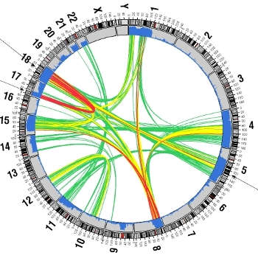

GENIE Data Model
n
OUTCOMES
*
Pancancer
  PDL1
  MSI
Treatments
rwOS
rwDFS
rwPFS
rwTTNT
rwTTD
rwTTR
Rx
  INN
  Start date
  Stop date
Cancer-specific
Demographics
Smoking status
Vital status
^
*PRISSMM is licensed from the DFCI
^HemOnc is available through a creative commons license
*CRC 2.0-public release ©2022 American Association for Cancer Research Project GENIE™
*12.0-public release ©2022 American Association for Cancer Research Project GENIE™

Slide 4

BPC CRC 2.0-public Cohort
11893
CRC
7172
2014 ≤ NGS ≤2018
4966
BPC Phase 1 Institutions
3057
Eligible & randomly selected
1,485 final cohort
*CRC 2.0-public release ©2022 American Association for Cancer Research Project GENIE™

Slide 5
BPC CRC 2.0-public Demographics
Age at Diagnosis
Sex
Primary Race
*CRC 2.0-public release ©2022 American Association for Cancer Research Project GENIE™

Slide 6
BPC CRC 2.0-public: Stage at Diagnosis
*CRC 2.0-public release ©2022 American Association for Cancer Research Project GENIE™

Slide 7
BPC CRC 2.0-public:
Sites of Metastases at Diagnosis
*CRC 2.0-public release ©2022 American Association for Cancer Research Project GENIE™

Slide 8
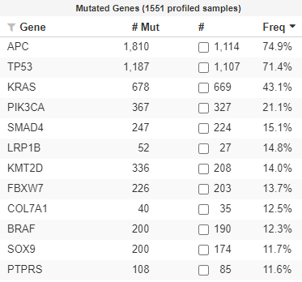
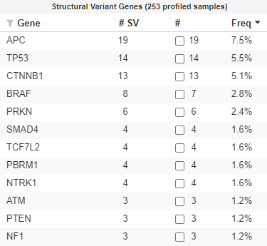
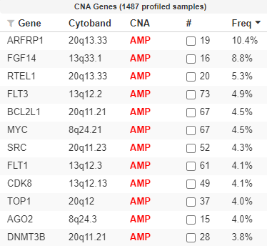
BPC CRC 2.0-public:
Detailed Clinical Genomics
*CRC 2.0-public release ©2022 American Association for Cancer Research Project GENIE™

Slide 9
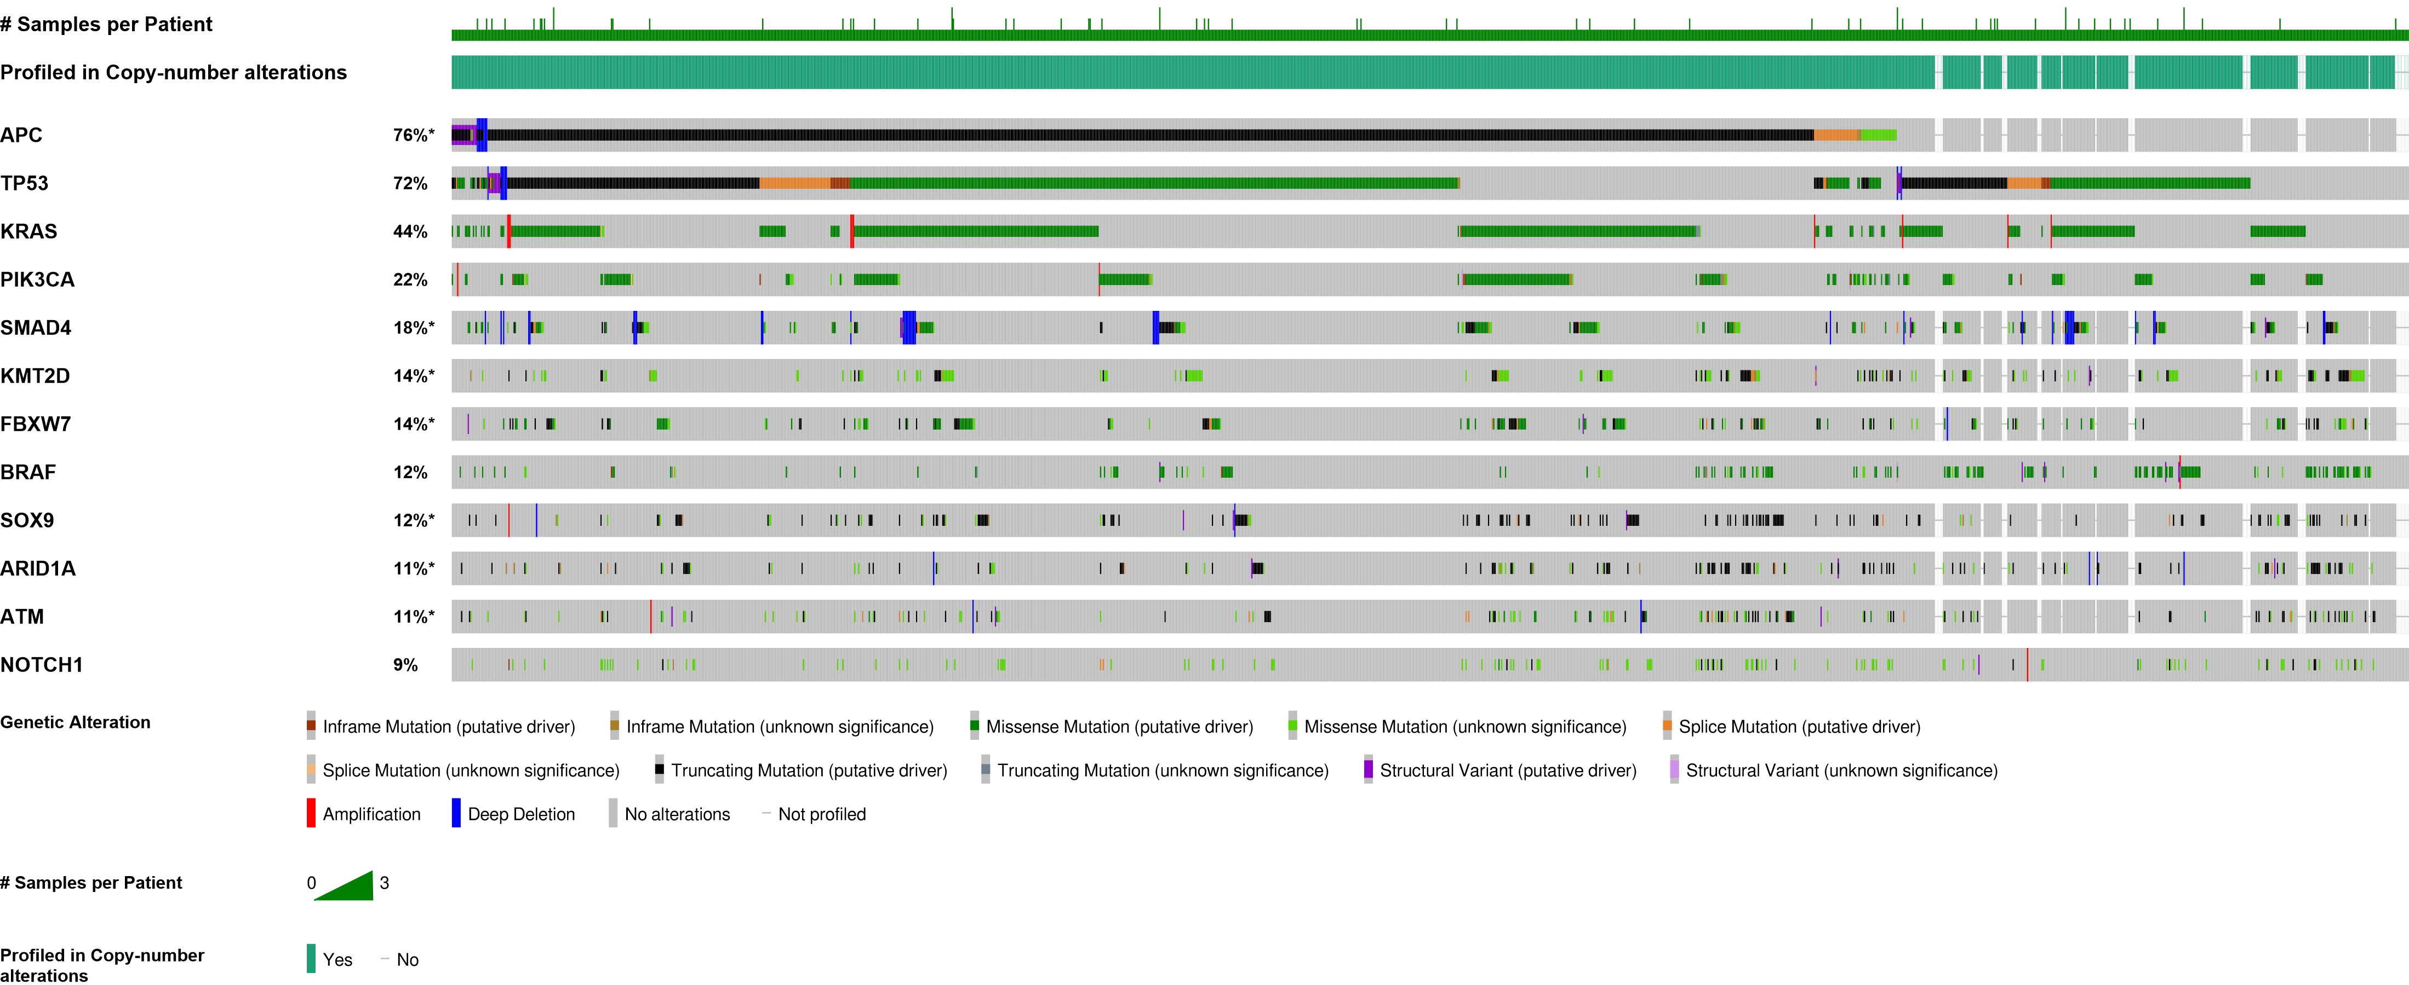
Top 12 Mutated Genes CRC 2.0-public

Slide 10
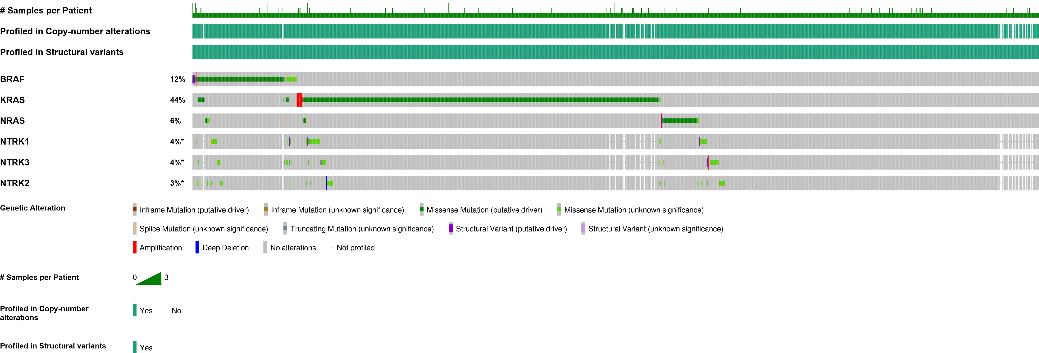



Clinically Actionable Genes CRC 2.0-public
Actionable Genes
Chakravarty et al., JCO PO 2017.

Slide 11
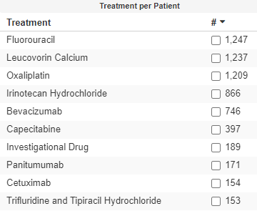
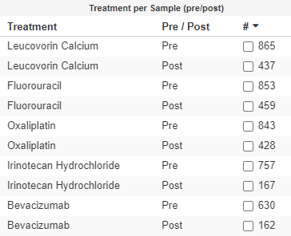
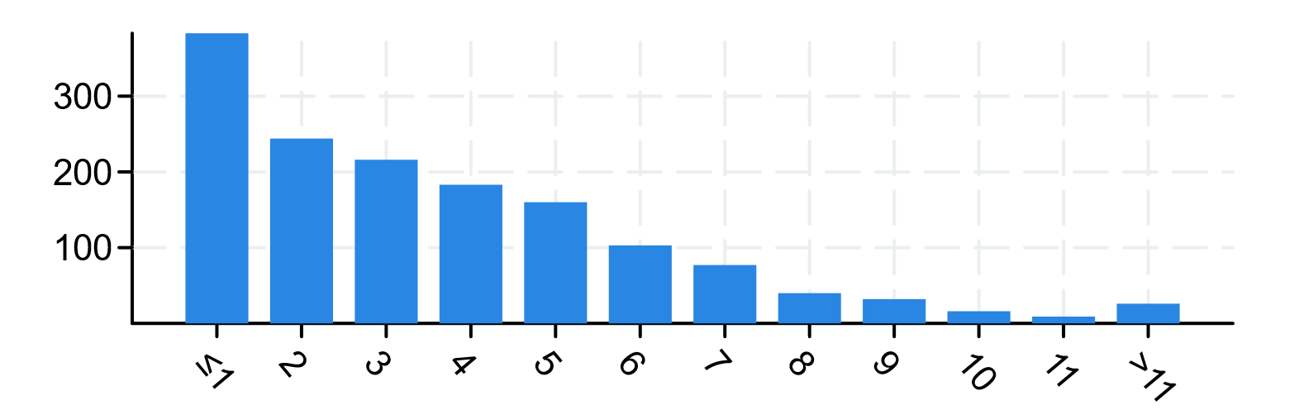
BPC CRC 2.0-public:
Complete Treatment Histories
Number of cancer-directed drug regimens curated for each patient
Treatments by Patient
Treatments by Sample (pre- and post-)
Cancer-directed Drug Regimens ​(Includes regimens ever received for CRC irrespective of line or stage)
Regimen​ | # of patients​
FOLFOX | 1172
FOLFOX + Bevacizumab | 702
FOLFIRI | 853
FOLFIRI + Bevacizumab | 665
Individual regimens can be calculated from the raw data found here on Synapse
Treatment history for non-index cancers can be found here on Synapse
*CRC 2.0-public release ©2022 American Association for Cancer Research Project GENIE™

Slide 12
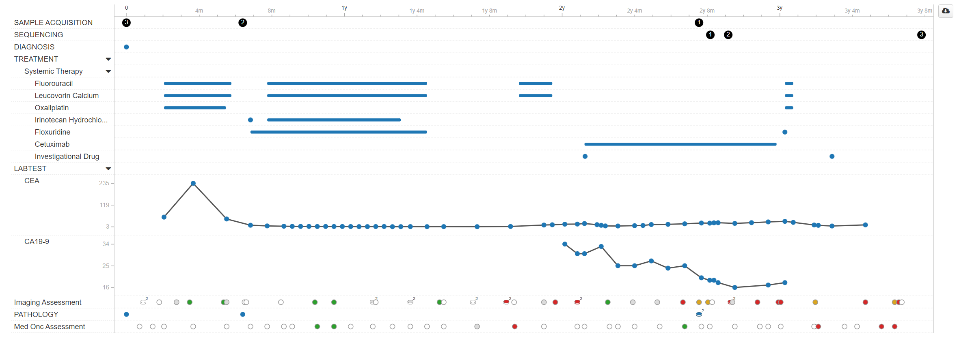
BPC CRC 2.0-public:
Comprehensive Patient View
Sample Patient
Pathology Reports
Disease Status by Medical Oncology Note and by Imaging

Slide 13
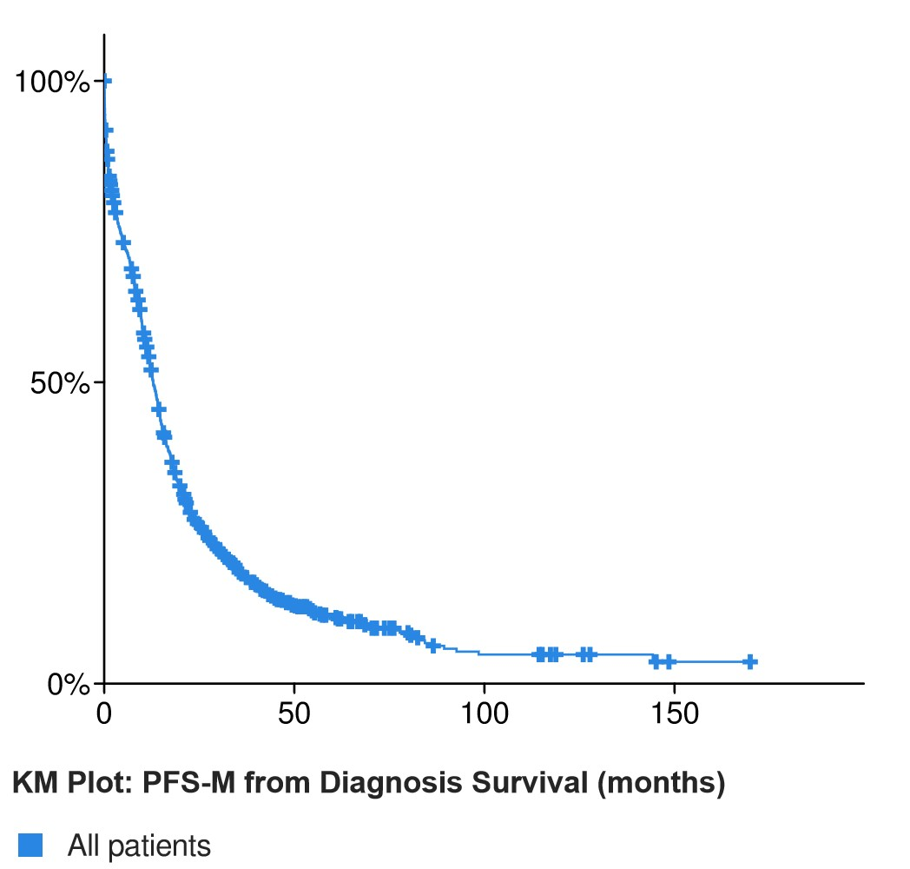
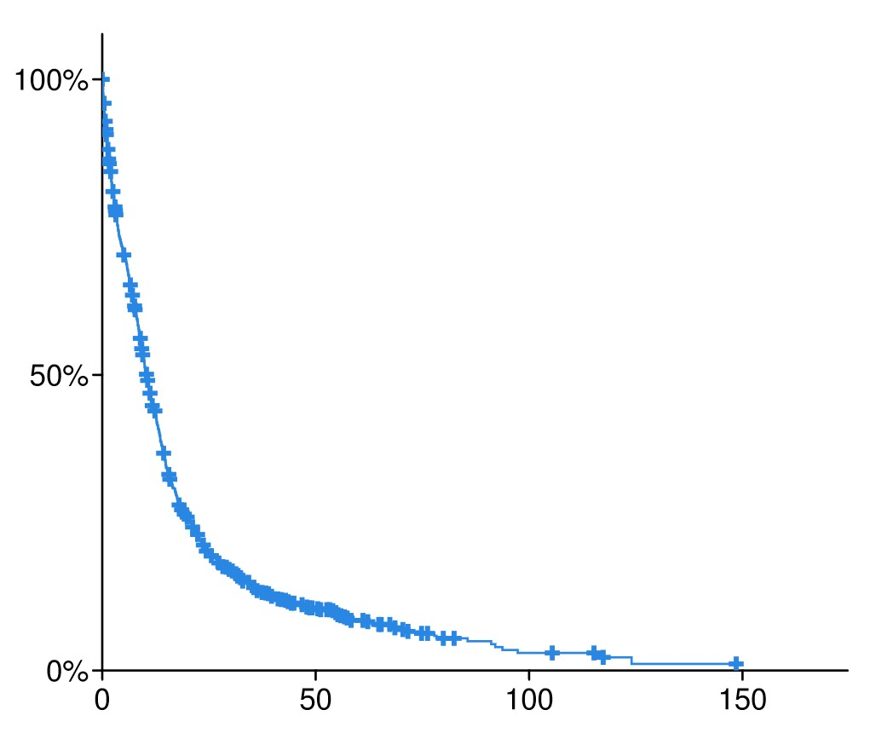
BPC CRC 2.0-public:
High Quality Clinical Data
PFS-M= 12.9 months
PFS-I= 10.3 months
PFS-M and PSF-I are available by regimen for those regimens containing greater than 10 patients
* Not adjusted for delayed entry

Slide 14
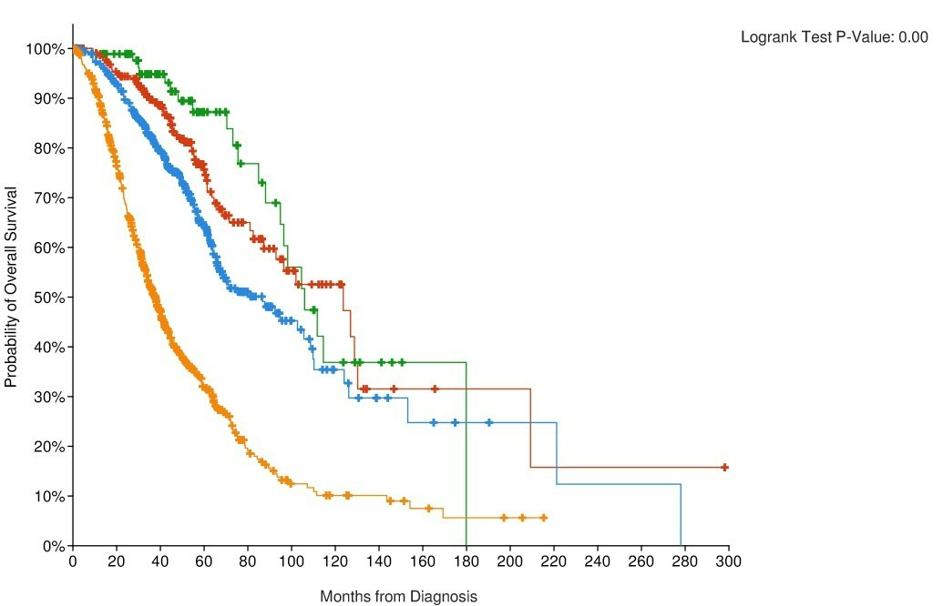
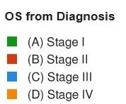
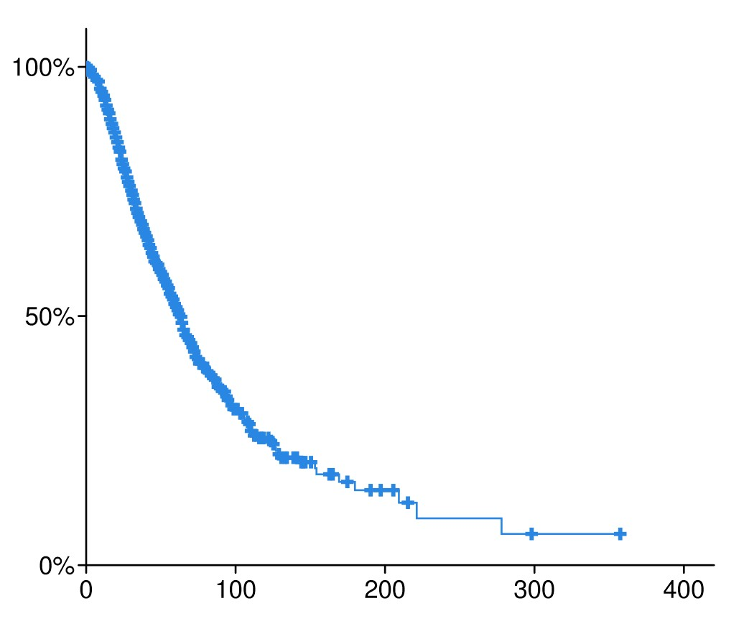
BPC CRC 2.0-public:
OS by Stage
OS all stages= 62.7 months
*not adjusted for delayed entry

Slide 15







GENIE BPC Acknowledgements
Gregory Riely
Deb Schrag
Julia Rudolph
Charles L. Sawyers
Hira Rizvi
John Phillip
Julian Schwartz
Marufur Bhuiya
Stu Gardos
Cynthia Chu
Shirin Pillai
Ken Kehl
Asha Postle
Ashley Newcomb
Kevin Haigis
John Orechia
Daniel Quinn
Simon Arango Baquero
Jeremy Warner
Michele Lenoue-Newton
Christine Micheel
Ben Ho Park
Sanjay Mishra
Daniel Fabbri
Marilyn Holt
Neha Jain
Protiva Rahman
Li Wen
Yuanchu James Yang
Kate Mittendorf
Shawn M. Sweeney
Michael Fiandalo
Jennifer Hoppe
Niki Schultz
Ben Gross
Ritika Kundra
Brooke Mastrogiacomo
Philippe Bedard
Celeste Yu
Samanta Del Rossi
Nitthusha Singaravelan
Demi Plagianakos
Alisa Nguyen
Nazish Qazi
Gunjan Srivastava
Sophie Cooke
Alisha Rizvi
Statistical Core
Kathy Panageas
Jessica Lavery
Samantha Brown
Axel Martin
Michael Curry
Xindi Guo
Thomas Yu
Chelsea Nayan
Former BPC Team Members can be found here

